Slide 1
GRE Resources: Roosevelt University

Slide 2
What is the GRE?
A critical step in the graduate school admission process
The GRE is a multiple-choice, computer-based standardized exam
Different than the MCAT (medical school), LSAT (law school), or GMAT (business programs)
GRE Sections
Analytical Writing (similar to the written section on the ACT)
Verbal Reasoning
Quantitative Reasoning
Scores range from 130-170

Slide 3
What is on the gre?
Content areas tested:
Basic arithmetic
Algebra
Geometry
Data analysis
Vocabulary
Reading comprehension and analysis

Slide 4
Section I: Practice Tests
Get a sense of your starting point and take a practice test to identify your strengths and weaknesses

Slide 5
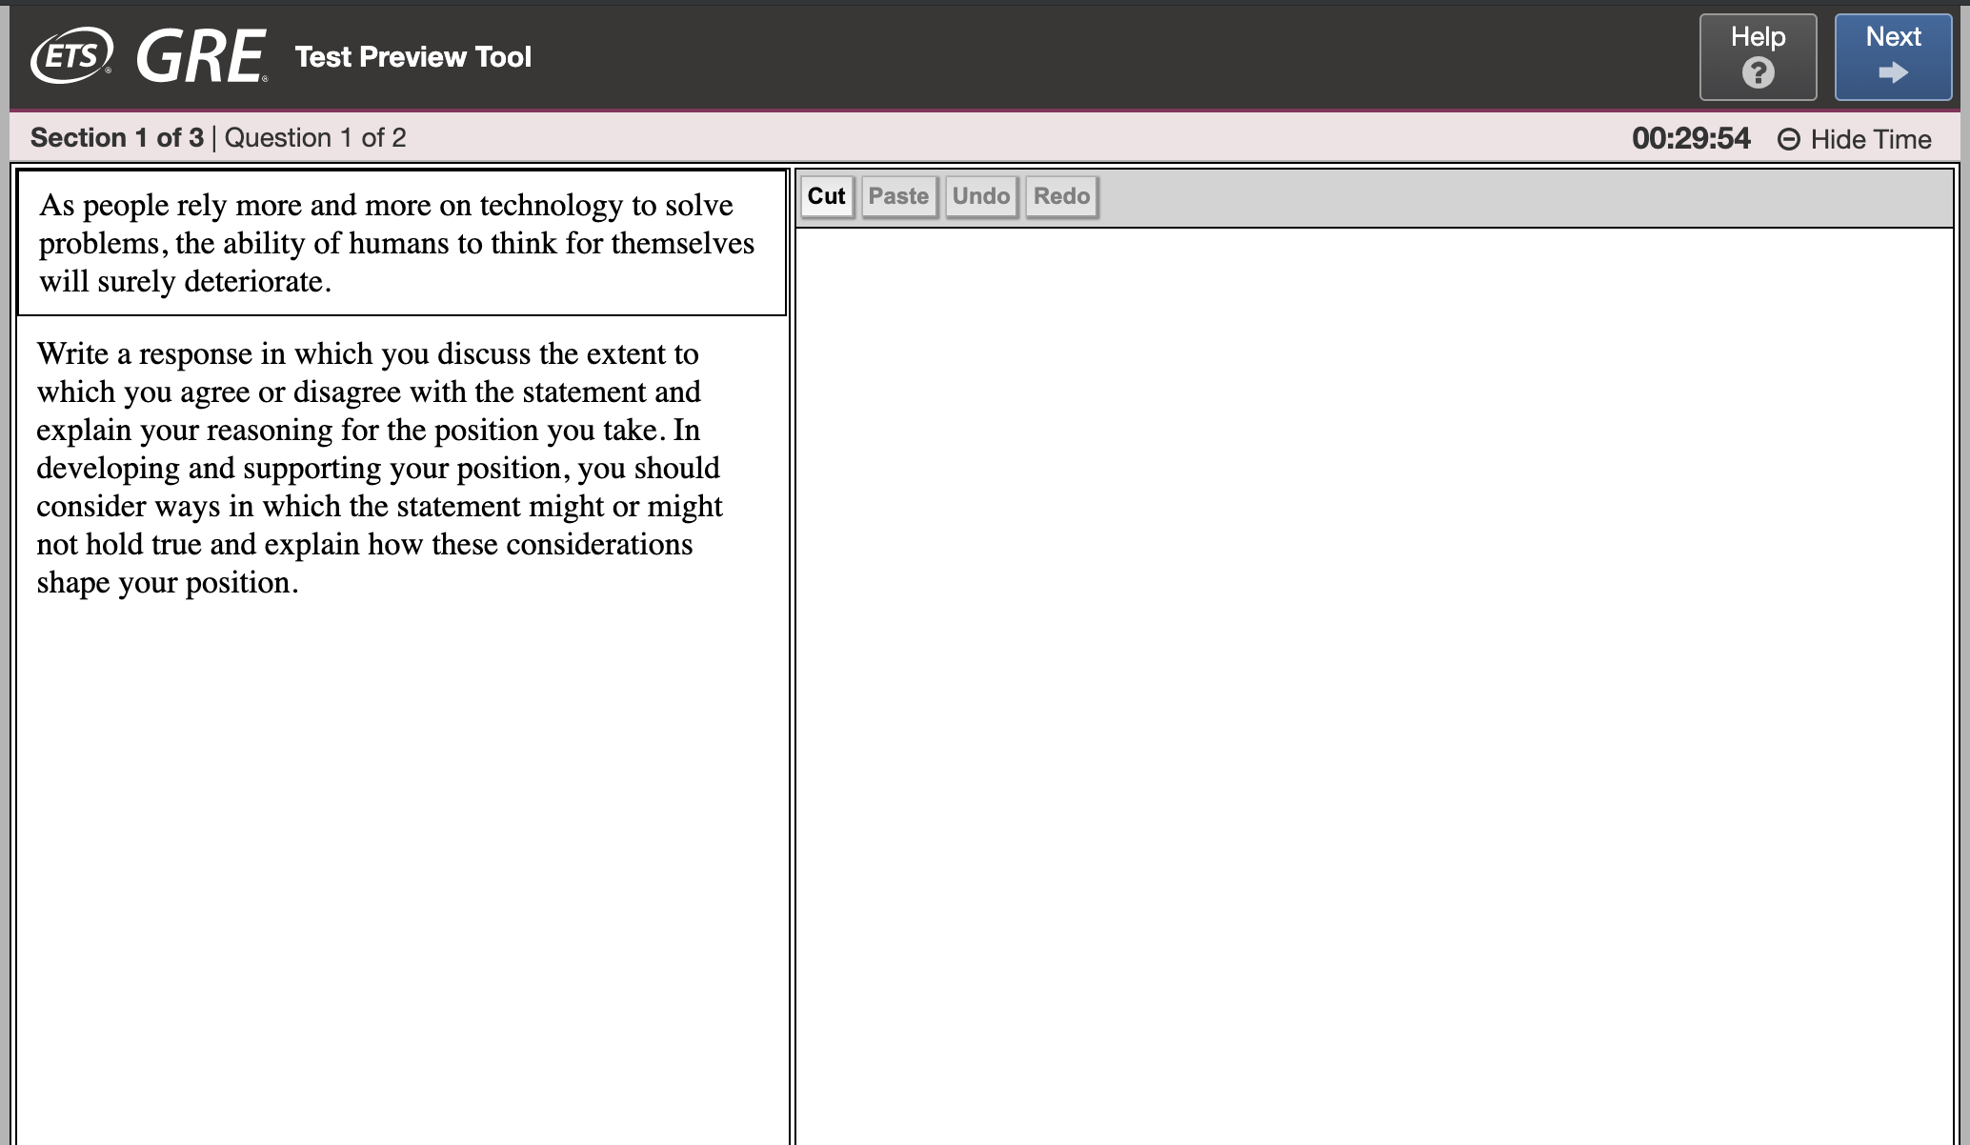
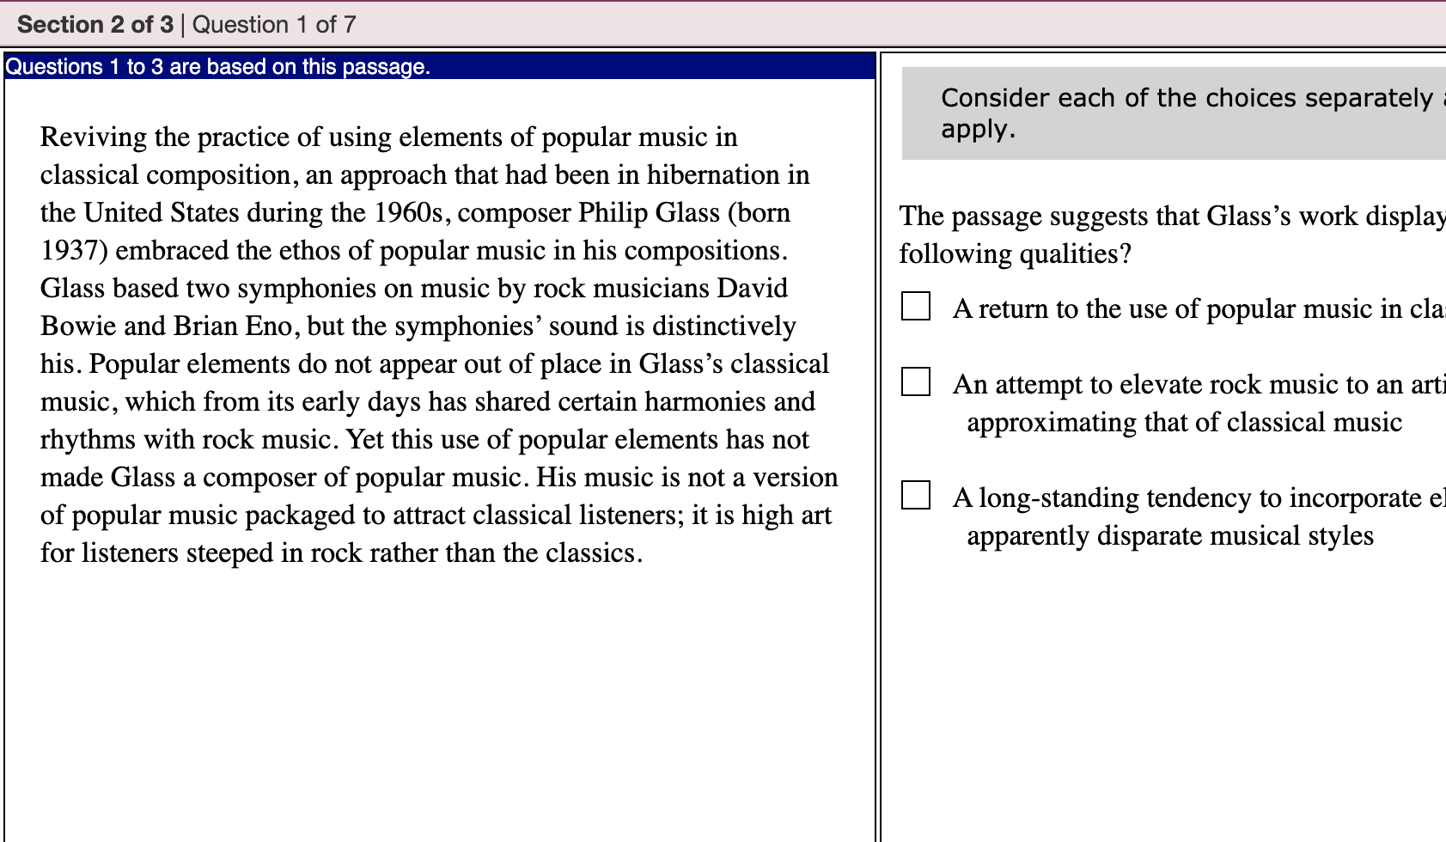
ETS GRE Practice Test
Best free prep option! Closest thing to the real test because questions are very similar to the real GRE
Pros: Created by the test designers. 2 free* tests available
Cons: No score on the written portion
*Need to make an account and “check out” with the 2 free tests in the cart - costs $0
https://www.ets.org/gre

Slide 6
Princeton Review Practice Tests
Great free practice test option!
Mimics real test with regard to layout and timing. Provides a score for written portion
All the portions are graded and individual feedback on areas of strength and weakness are identified. The questions are slightly more challenging than the real test.
https://www.princetonreview.com/grad/free-gre-practice-test?ceid=tersh-nav-test-prep#!practice

Slide 7
Kaplan Prep: Practice Test
Not as good as ETS or Princeton Review
Need to sign up for an account, but one free online test is provided upon creation of the account
Test simulates the real test with regard to layout and timing
All the portions are graded and individual feedback is provided. The written portion is not graded.
https://www.kaptest.com/gre/free/gre-practice-test-options?_ga=2.11573564.98721432.1571934511-1857673149.1571934511

Slide 8
Section II: Content Practice
Now that you’ve figured out your strengths and areas for growth…
turn your attention to sharpening your knowledge in those areas.

Slide 9
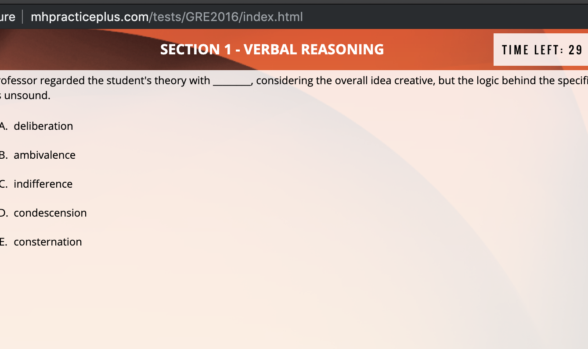
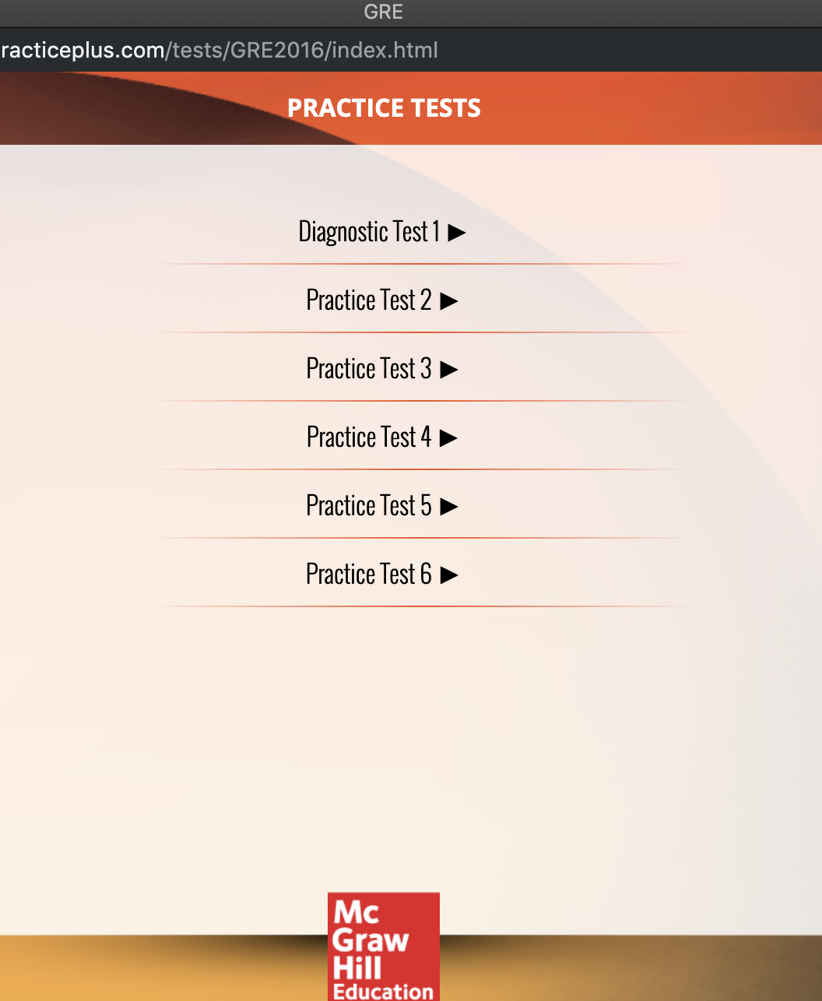
MHPractice Plus
Pros: Offers 7 free practice tests. Videos are available for some content areas.
Cons: Questions are a bit more challenging than the real GRE
This is a good free resource, however, it should be supplemented by official ETS prep material, the Princeton Review, or Manhattan Prep’s 5lb book
http://www.mhpracticeplus.com/gre.php

Slide 10
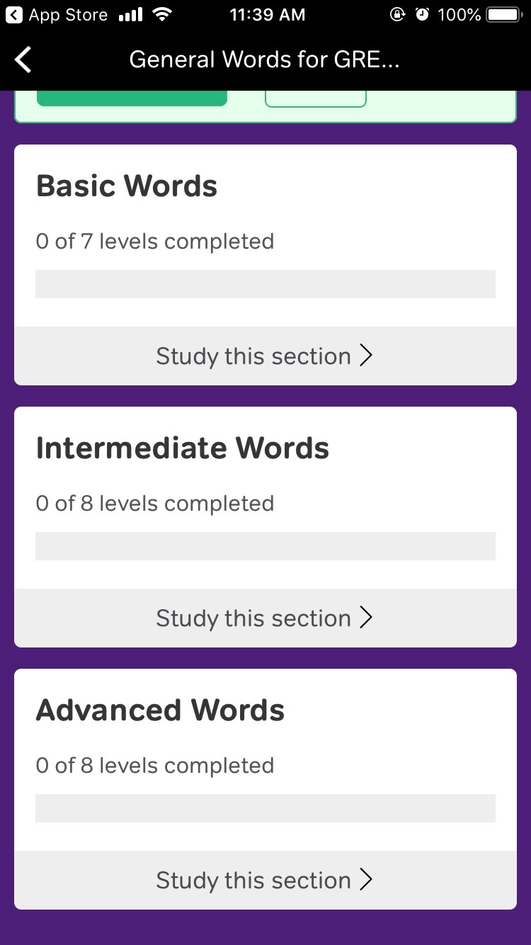
Magoosh
HIGHLY recommend downloading the free Vocabulary Builder app. Most of the words appear on the real Verbal section
https://apps.apple.com/us/app/vocabulary-builder-by-magoosh/id890252250

Slide 11
GRE PrepScholar
This is a good cost-effective online tutoring option, but other methods (such as books) are more comprehensive.
Register for free math bootcamp
Free 5-day trial includes diagnostic exam, interactive lessons and strategies, and individualized study plan.
6 month membership costs $38 and includes more practice questions and practice exams online
https://gre.prepscholar.com/resources/

Slide 12
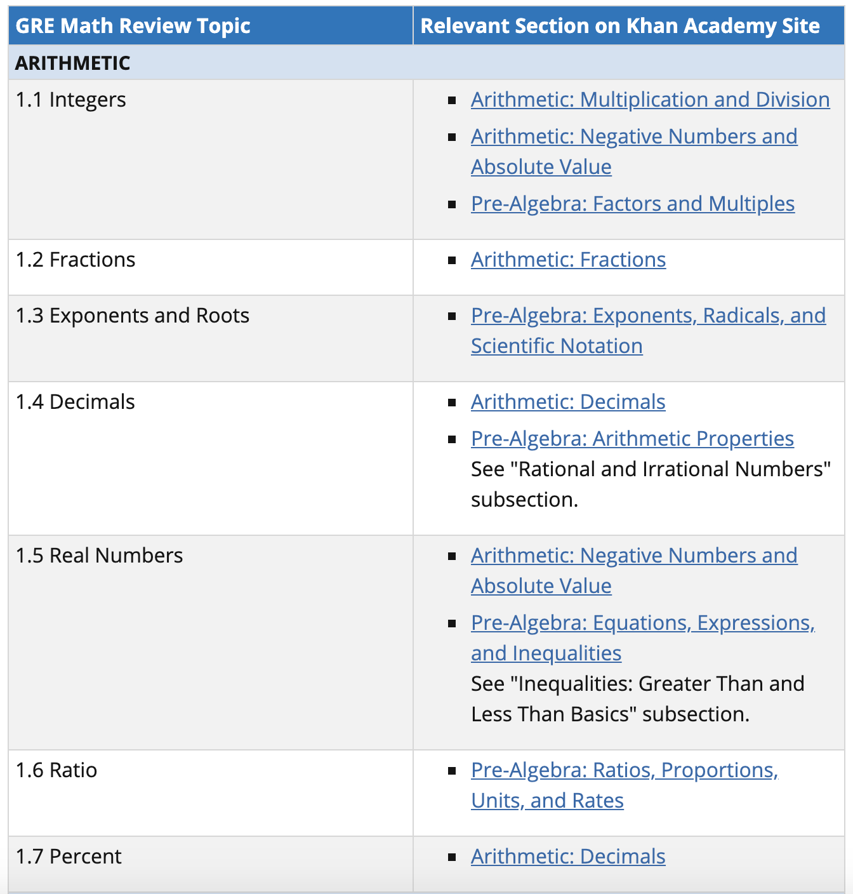
ETS GRE Math Practice
Free PDF of math portion of the book. Includes practice questions and explanations.
The quantitative review is thorough in its coverage of math knowledge needed for the exam. The Khan Academy videos are a good supplement if a specific content area is challenging.
Khan Academy/ETS Math Videos: https://www.ets.org/gre/revised_general/prepare/khan_academy
https://www.ets.org/s/gre/pdf/gre_math_review.pdf

Slide 13
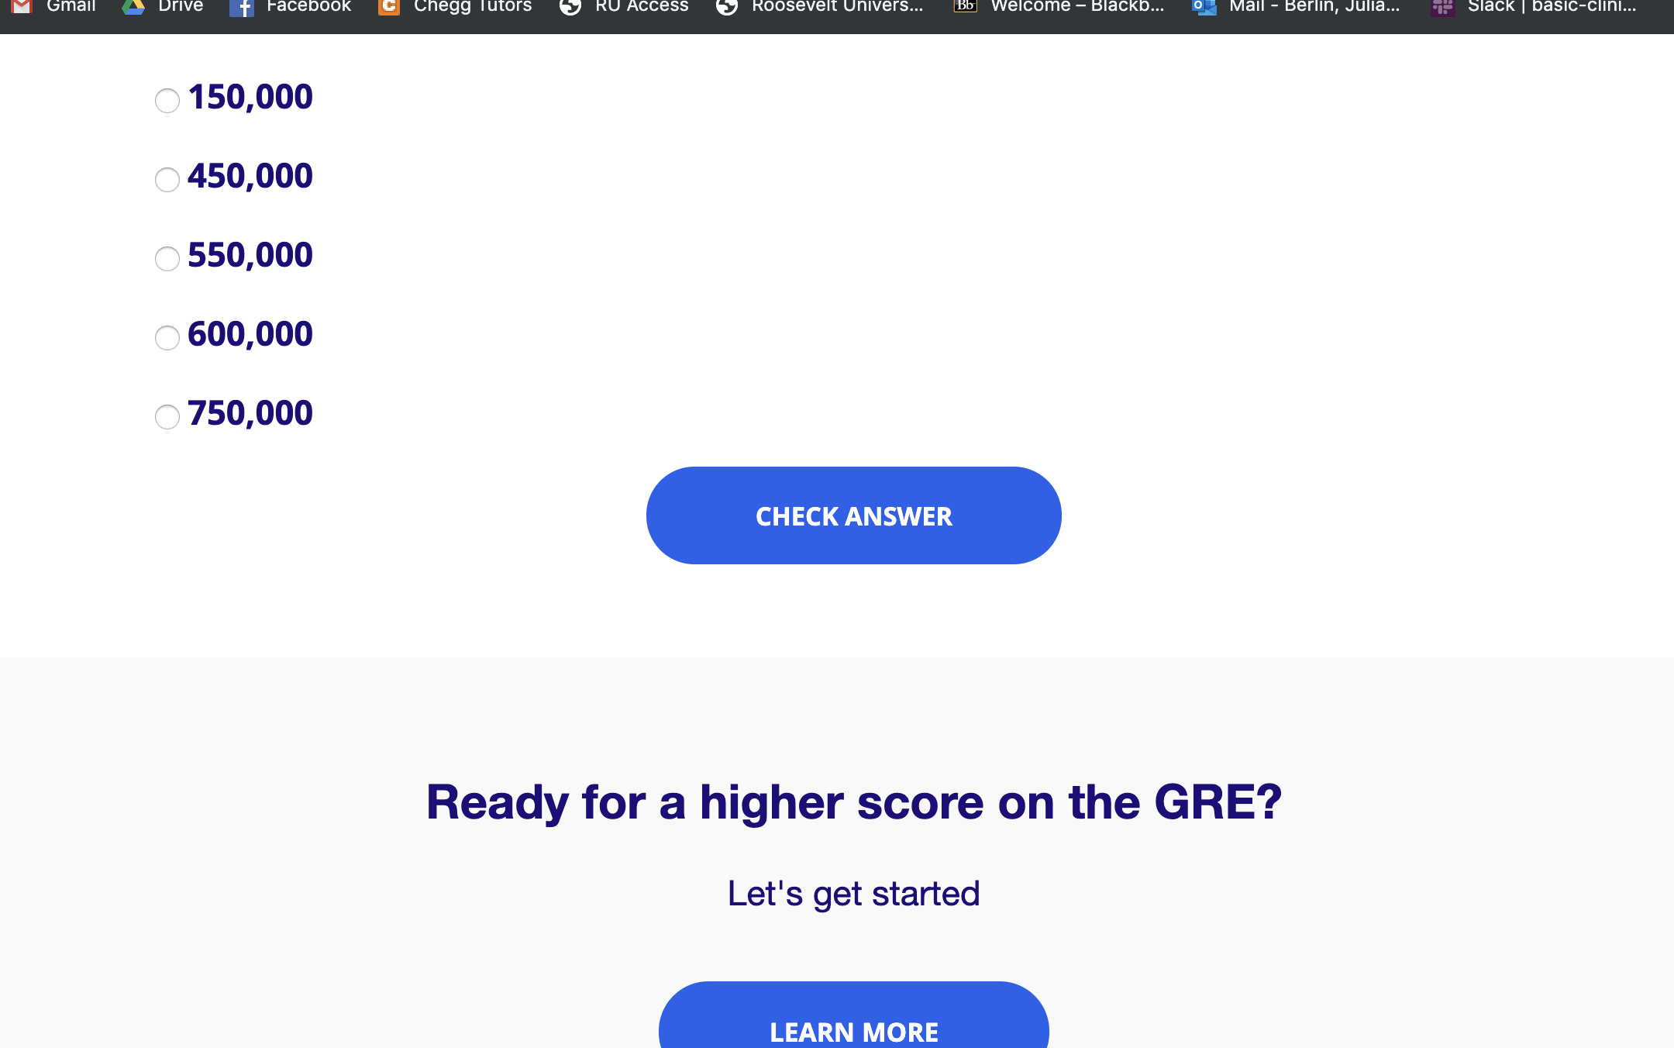
Kaplan Prep: Question of the Day
Sign up for Kaplan emails to receive a free question of the day
This is a good, free, but limited resource. Answering a question a day is helpful, but do not rely on this for complete preparation
http://kaplanquizzes.com/gre/

Slide 14
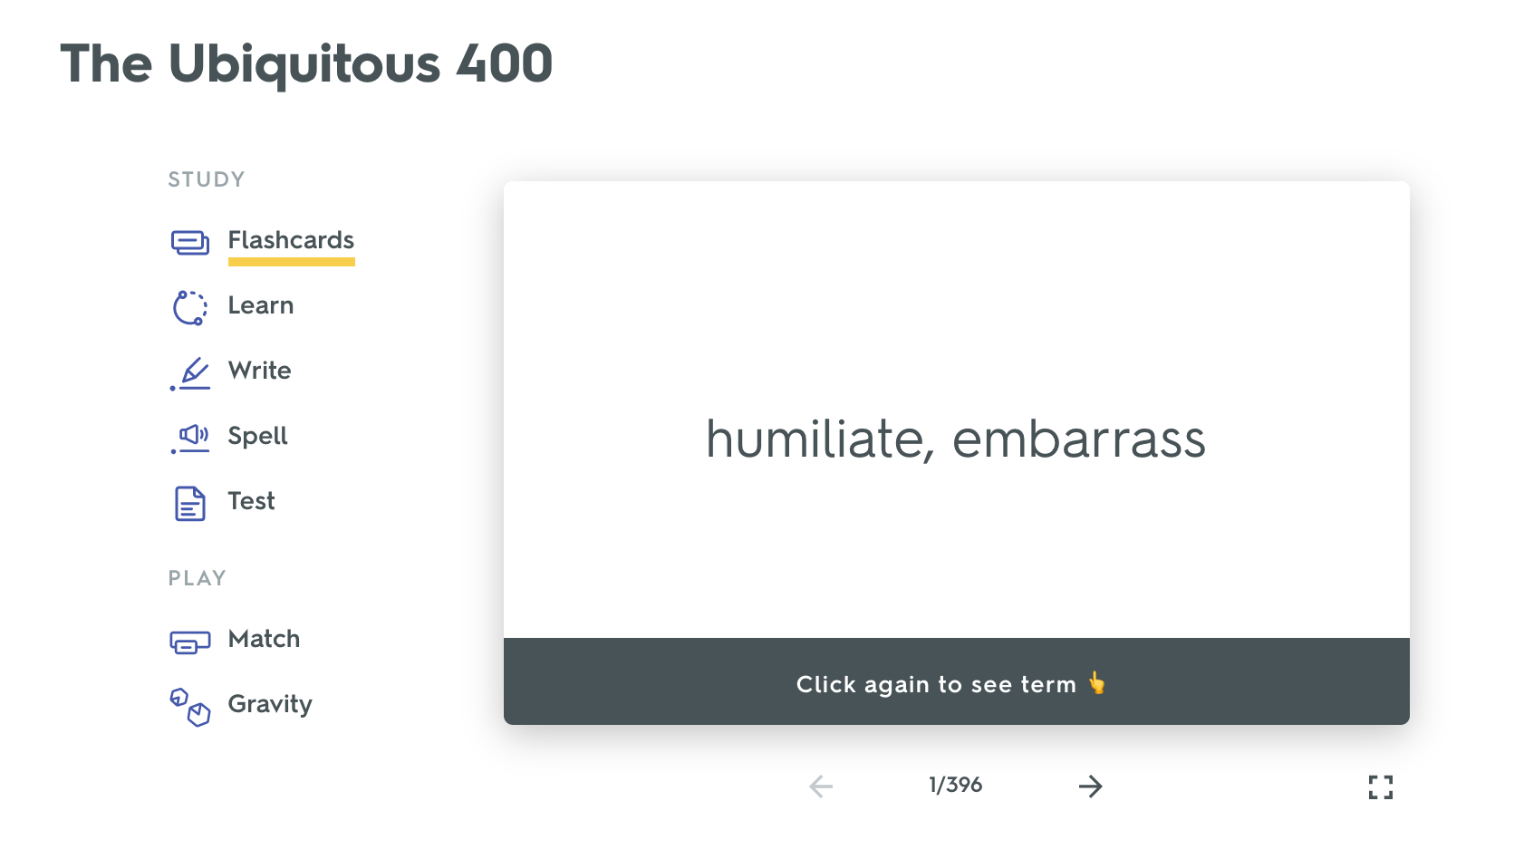
Quizlet: Common Vocab Questions
Vocabulary set for common GRE words
https://quizlet.com/5865446/the-ubiquitous-400-flash-cards/

Slide 15
Section III: Recommended Books
GRE books provide content explanations and practice questions,
while online content practice only provides questions.

Slide 16
Official GRE Super Power Pack ($36)
BEST DEAL if student is planning to buy any of the ETS books
Includes Guide to the GRE General Test, Quantitative Practice Questions, and Verbal Reasoning Practice Questions
Feedback provided for each question is thorough

Slide 17
Manhattan Prep: 5 lb Book of GRE Practice Problems ($20)
This book has the MOST practice questions (with explanations) for each section. The questions are quite similar to the question style on the test.
No practice tests in the book, but includes 1,800+ practice questions with explanations

Slide 18
Princeton Review: Cracking the GRE ($15)
The inclusion of the online tests make this a great deal!
4 practice tests (2 online, 2 in the book)
Review chapters for quantitative and verbal sections
Detailed explanations provided for practice questions and test questions

Slide 19
Section IV: Events

Slide 20
Kaplan Free Events
Free online class opportunities. Students are able to ask questions in live chat. Teachers are available to answer questions.
Activities include practice questions and tips on specific types of questions
https://www.kaptest.com/gre/free/events?utm_medium=Email&utm_source=SFMC&utm_campaign=ROLLING+-+GRE+-+LOL+Weekly+Event+Alert+-+EVNT+-+JR+SR+YP+BL&et_rid=404668486

Slide 21
Section V: gre subject test in psychology

Slide 22
What about the psychology Gre?
Most master’s level psychology programs DO NOT require the test, but some doctoral level programs DO
Schools that require it vary – no general rule about programs requiring it or not
Check with each program on your list to see if the test is required
Consists of 205 multiple choice questions based on introductory psychology coursework
Offered three times a year (September, October, and April) → PLAN ACCORDINGLY

Slide 23
How do I study for the psychology gre?
Recommended: Get the Kaplan psychology book
Take a test to identify what you know and what you need to study
Review those concepts in the book!

