Slide 1
Writing the Urban Landscape Literature, Environmental Studies, & the Sustainable Future of Cities
Mike Bryson Associate Professor of Humanities & Sustainability Studies Roosevelt University
Environmental Studies Program Research Presentation
Roanoke College
14 January 2014

Slide 2
Methods and Contexts: Urbanization, environmental studies, and the practice of ecocriticsm
Urban Nature: Loren Eiseley, Leonard Dubkin, and the wilderness of cities
Reading (and Writing) the Landscape: May Watts and the art of ecology
Future Prospects: Literature, science, and the sustainability of cities and suburbs
Photo: W. Mahone via downtownRoanoke.com

Slide 3
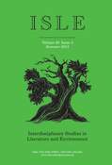
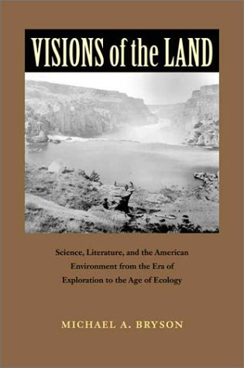
Ecocriticism and Environmental Studies
Interdisciplinary method of inquiry
Critical interrogation of literature, film, policy, science, and all manner of environmental discourse
Part of the multidisciplinary field of environmental studies
Rooted in the engagement of the arts and humanities with ecological problems and environmental issues
Notes:
What's the take-away of Eiseley's work? Not that he had all the answers – far from it – but that he thought about cities as interesting biological landscapes that revealed much about how our species uses (and abuses) land and resources.

Slide 4
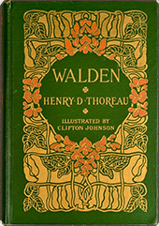
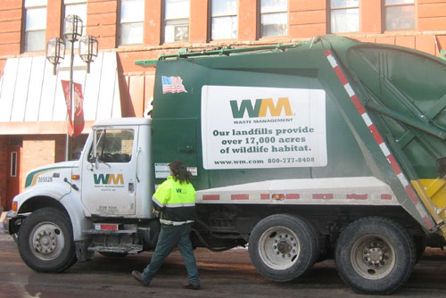
Ecocriticism: All the World's a Text
Notes:
What's the take-away of Eiseley's work? Not that he had all the answers – far from it – but that he thought about cities as interesting biological landscapes that revealed much about how our species uses (and abuses) land and resources.

Slide 5
Global Urbanization in 2011
Source: United Nations, Department of Economic and Social Affairs, Population Division. World Urbanization Prospects, the 2011 Revision. New York, 2012
Notes:
The biophysical environment of city and suburb serve multiple (and sometimes conflicting) functions in Loren Eiseley’s prose and poetry. For Eiseley the writer, naturalist, and evolutionary biologist, contact with nature in the cityscape establishes a literary sense of place and validates the ecological worth of the urban biota, however common or marginal the latter may be.

Slide 6
Global Urbanization: 2025 Projection
Source: United Nations, Department of Economic and Social Affairs, Population Division. World Urbanization Prospects, the 2011 Revision. New York, 2012
Notes:
The biophysical environment of city and suburb serve multiple (and sometimes conflicting) functions in Loren Eiseley’s prose and poetry. For Eiseley the writer, naturalist, and evolutionary biologist, contact with nature in the cityscape establishes a literary sense of place and validates the ecological worth of the urban biota, however common or marginal the latter may be.

Slide 7
Two Persistent Perceptions of Cities
Chicago Loop, seen from "The Brownlands" (Ryan Hodgson-Rigsbee)
City vs. Nature
Fosters the illusion of technology-mediated independence from the natural world as well as a profound yet often unfulfilled longing for contact with wildness within a polluted and biologically-impoverished cityscape.
City as Living Ecosystem
Recognizes that cities and suburbs comprise a complex urban ecosystem, a dynamic mosaic in which imperiled nature interacts with humans and their built environment, and where the idea of "natural" can be interrogated.
Notes:
Eiseley’s work expresses these tensions, and persuades us that urbanized areas are both important sites of human contact with nature as well as places in which biodiversity can be conserved and the idea of "the natural" critically interrogated.

Slide 8
Urban Nature
Central Park in New York
Notes:
The biophysical environment of city and suburb serve multiple (and sometimes conflicting) functions in Loren Eiseley’s prose and poetry. For Eiseley the writer, naturalist, and evolutionary biologist, contact with nature in the cityscape establishes a literary sense of place and validates the ecological worth of the urban biota, however common or marginal the latter may be.

Slide 9
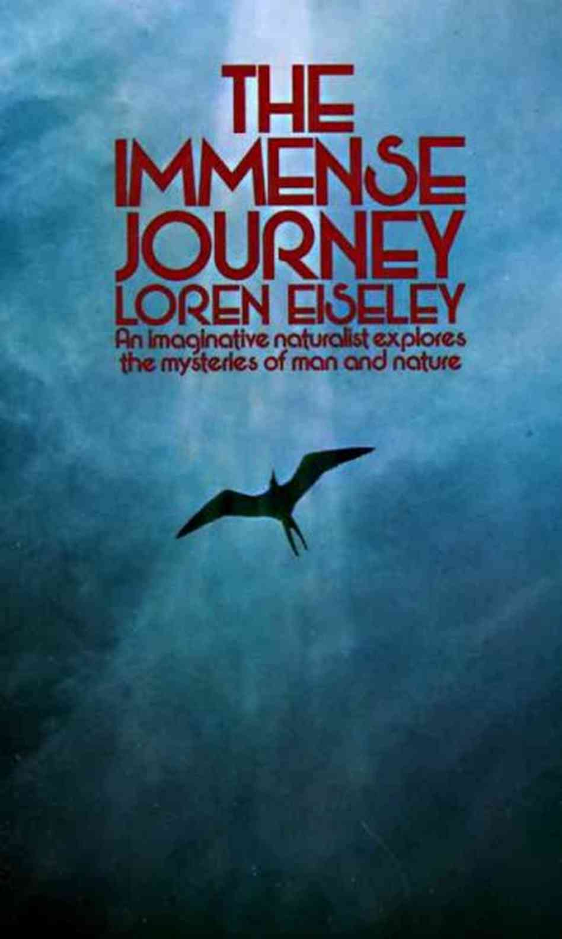
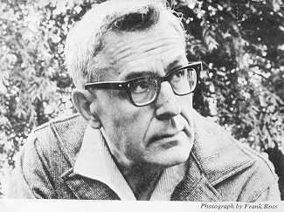
Loren Eiseley: Scientist & Nature Writer
Loren Eiseley (1907-1977)
Notes:
What's the take-away of Eiseley's work? Not that he had all the answers – far from it – but that he thought about cities as interesting biological landscapes that revealed much about how our species uses (and abuses) land and resources.

Slide 10
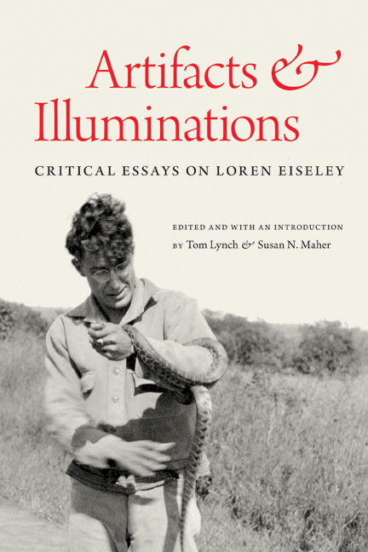
Unearthing Urban Nature Loren Eiseley's Explorations of City and Suburb (2012)
Influenced by key places: Lincoln, NE; Philadelphia; New York City.
Characterized by recognition of urban and suburban biodiversity, observation of everyday nature, and critique of human environmental impacts.
Relevant as a harbinger of contemporary urban ecology and sustainability.
Validation of art and literature's relevance to the revitalization of cities and representation of urban nature.
Notes:
What's the take-away of Eiseley's work? Not that he had all the answers – far from it – but that he thought about cities as interesting biological landscapes that revealed much about how our species uses (and abuses) land and resources.

Slide 11
Eiseley and the Urban Landscape
Bubbly Creek, South Side of Chicago, 2009 (M. Bryson)
What he saw (and still pertains):
Impacts of sprawl & pollution
Human alienation from nature
Decay of urban infrastructure
Biological paucity of manicured nature
The city as ecosystem subject to evolutionary change
Cities as sites of decay/illness
What's happened since:
Sprawl and more sprawl
Environmental regulations
Re-imagination of wilderness in the city
Biodiversity mapping & urban sustainability
Ecological restoration (rivers, prairies, wetlands, woodlands)
Notes:
Where we've come from the days of Eiseley's urban nature explorations and environmental critique of the city

Slide 12
Nature in Chicago
Suburban sprawl in the Chicago suburb of Shorewood, IL, summer 2006 (M. Bryson)
Notes:
Big impacts: Eiseley frequently fashions the city into a powerful metaphor of humanity’s global environmental impact -- a potent symbol and unsettling literal expression of the human species' rampant growth and voracious consumption of natural resources. Urban sprawl is like a cancer on the landscape.

Slide 13
Nature in Chicago
Life on the retaining wall – Bubbly Creek, South Side of Chicago (M. Bryson)
Notes:
Yet, his literary urban landscape is also a setting haunted by visions of decay and decline, of a crumbling technological civilization succumbing to the inevitable forces of nature reclaiming dominion.

Slide 14
Nature in Chicago
Parkland design -- Stearns Quarry Park (est. 2009), South Side of Chicago (M. Bryson)
Notes:
The biophysical environment of city and suburb serve multiple (and sometimes conflicting) functions in Loren Eiseley’s prose and poetry. For Eiseley the writer, naturalist, and evolutionary biologist, contact with nature in the cityscape establishes a literary sense of place and validates the ecological worth of the urban biota, however common or marginal the latter may be.

Slide 15
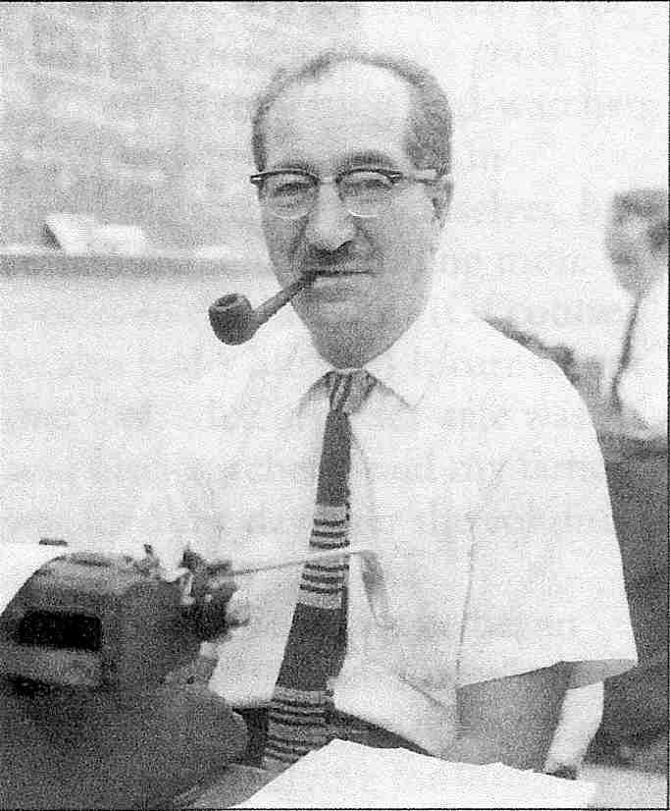
Leonard Dubkin: Chicago's Nature Writer
The Murmur of Wings (1944)
Enchanted Streets: The Unlikely Adventures of an Urban Nature Lover (1947)
The White Lady (1952)
Wolf Point: An Adventure in History (1953)
The Natural History of a Yard (1955)
My Secret Places: One Man’s Love Affair with Nature in the City (1972)
Leonard Dubkin (1905-1972)
Notes:
What's the take-away of Eiseley's work? Not that he had all the answers – far from it – but that he thought about cities as interesting biological landscapes that revealed much about how our species uses (and abuses) land and resources.

Slide 16
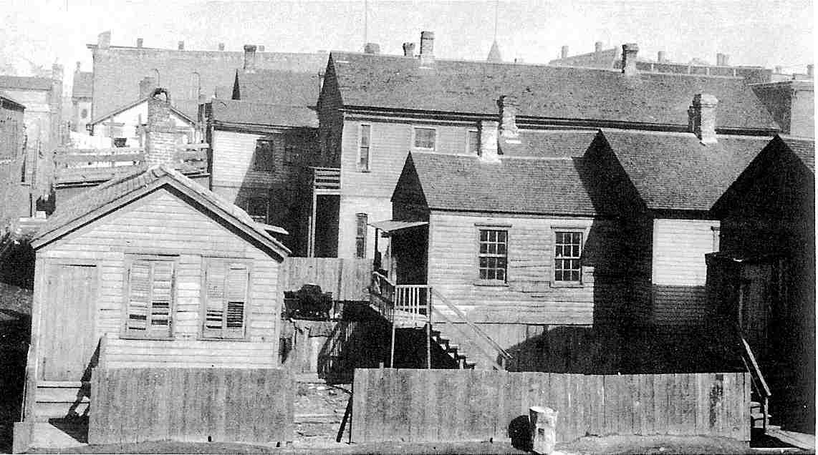
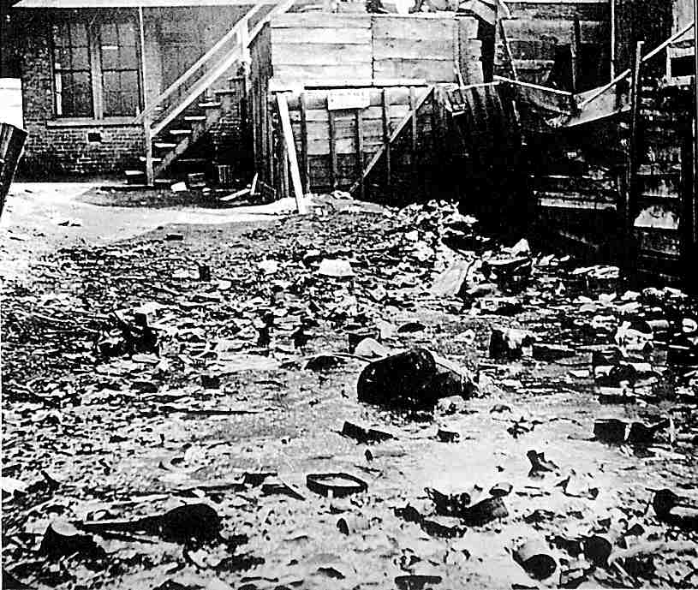
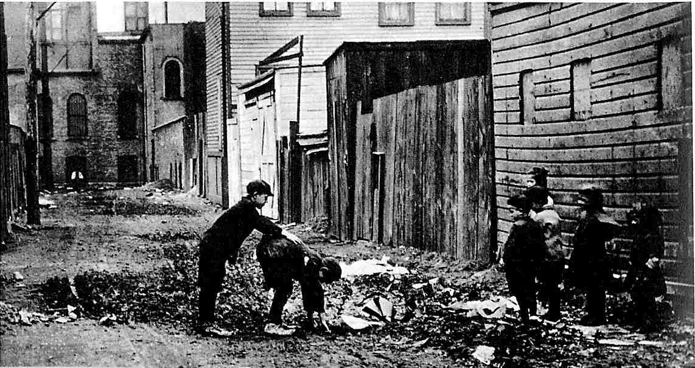
Chicago, early 20th century – Jefferson St., c.1906 (left),
South Side alley (below left),
Slum-area back yard (below)
Source: Chicago Historical Society archives

Slide 17
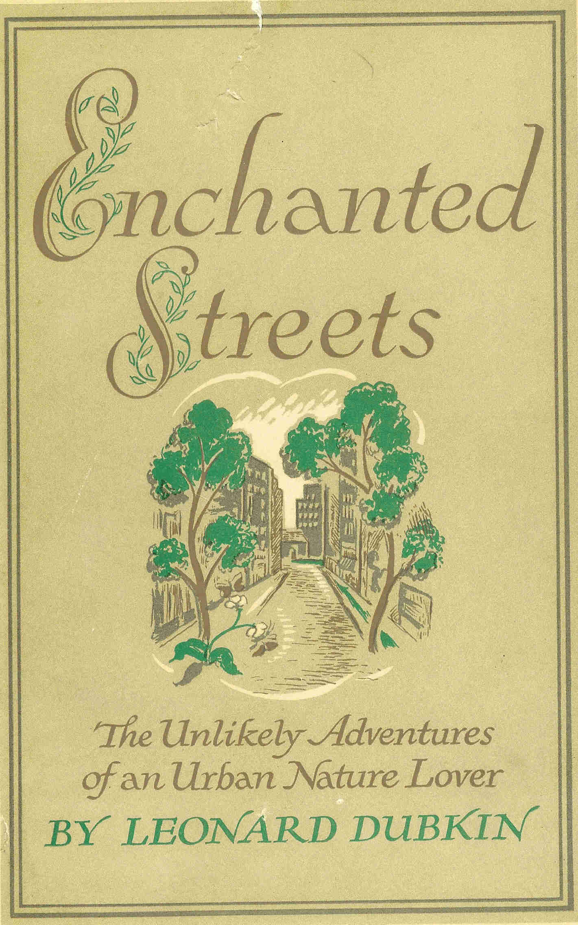
Empty Lots and Secret Places Leonard Dubkin's Explorations of Urban Nature in Chicago (2011)
Value of commonplace nature in cities, suburbs, and towns
Patient observation and direct experience
Connection of people with nature in urban environs
Challenge to symbolic constructions of “wilderness” and “city”
Harbinger of contemporary urban environmentalism and "Chicago Wilderness" movement

Slide 18
Nature in the Neighborhood
Dubkin Park, North Side of Chicago (M. Bryson)
Notes:
Yet, his literary urban landscape is also a setting haunted by visions of decay and decline, of a crumbling technological civilization succumbing to the inevitable forces of nature reclaiming dominion.

Slide 19
Nature in the Neighborhood
Dubkin Park, North Side of Chicago (Mapquest, 2008)
Notes:
Yet, his literary urban landscape is also a setting haunted by visions of decay and decline, of a crumbling technological civilization succumbing to the inevitable forces of nature reclaiming dominion.

Slide 20
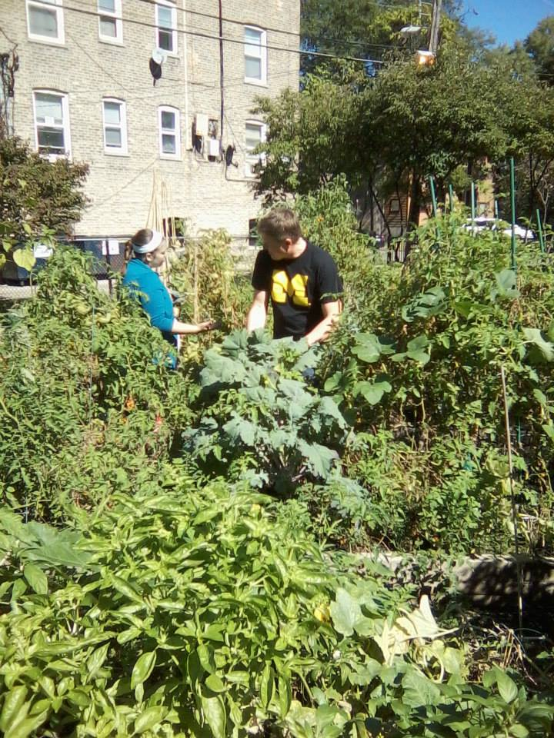
Re-envisioning Dubkin Park
Dubkin Park Community Garden, North Side of Chicago, ~2012
Notes:
Yet, his literary urban landscape is also a setting haunted by visions of decay and decline, of a crumbling technological civilization succumbing to the inevitable forces of nature reclaiming dominion.

Slide 21
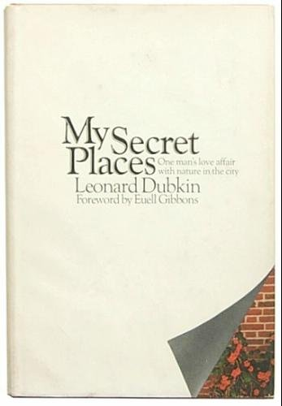
The Joys of Research
Carbon-copy of dust jacket blurb for Dubkin’s last book, My Secret Places (1972) – contained in a 1972 letter from Eiseley to Dubkin
Notes:
Yet, his literary urban landscape is also a setting haunted by visions of decay and decline, of a crumbling technological civilization succumbing to the inevitable forces of nature reclaiming dominion.

Slide 22
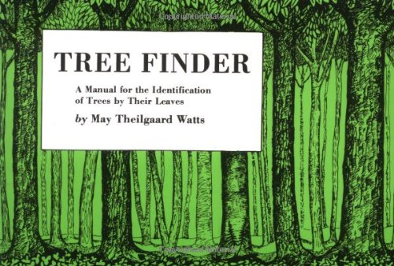
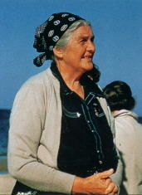
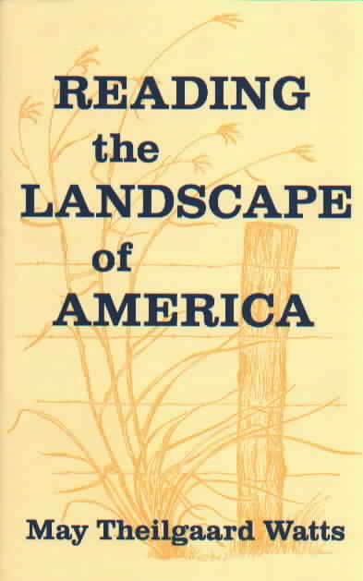
Reading the Book of Nature May Watts and the Art of (Teaching) Ecology (2014, in progress)
May Watts (1893-1975)

Slide 23
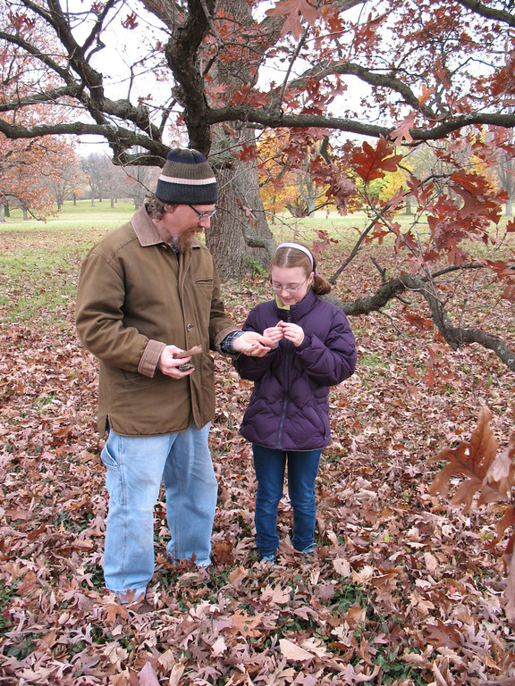
The Morton Arboretum
Sterling Morton Library at the Morton Arboretum (above)
Spending time with a bur oak, Fall 2011 (right)
Notes:
Yet, his literary urban landscape is also a setting haunted by visions of decay and decline, of a crumbling technological civilization succumbing to the inevitable forces of nature reclaiming dominion.

Slide 24
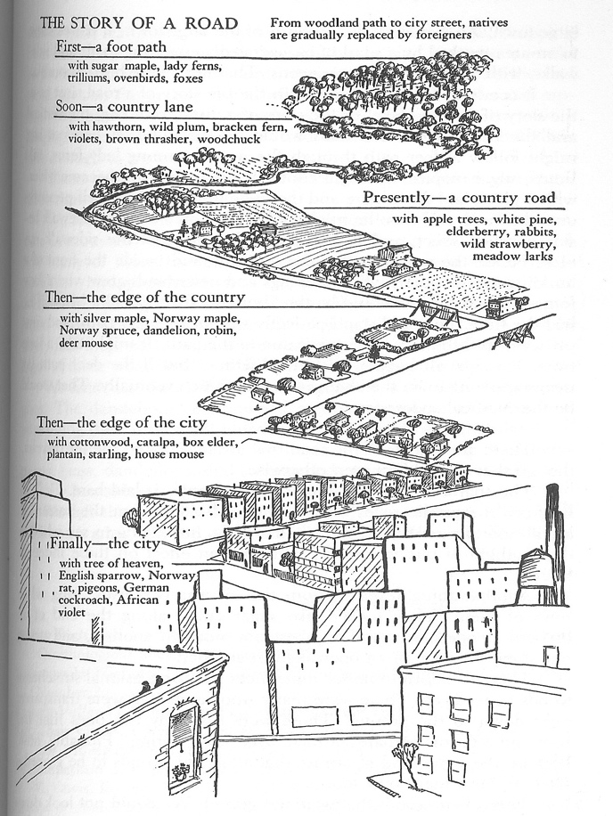
Ecology as the Study of Change
"There is good reading on the land, first-hand reading, involving no symbols.
"The records are written in forests, in fencerows, in bogs, in playgrounds, in pastures, in gardens, in canyons, in tree rings. . . .
"This ecology . . . Finds a story in a schoolyard, in the corner of an old cemetery, in a foundation planting, and even in a window box."
May Watts, Reading the Landscape of America, Preface to the 1st Ed.

Slide 25
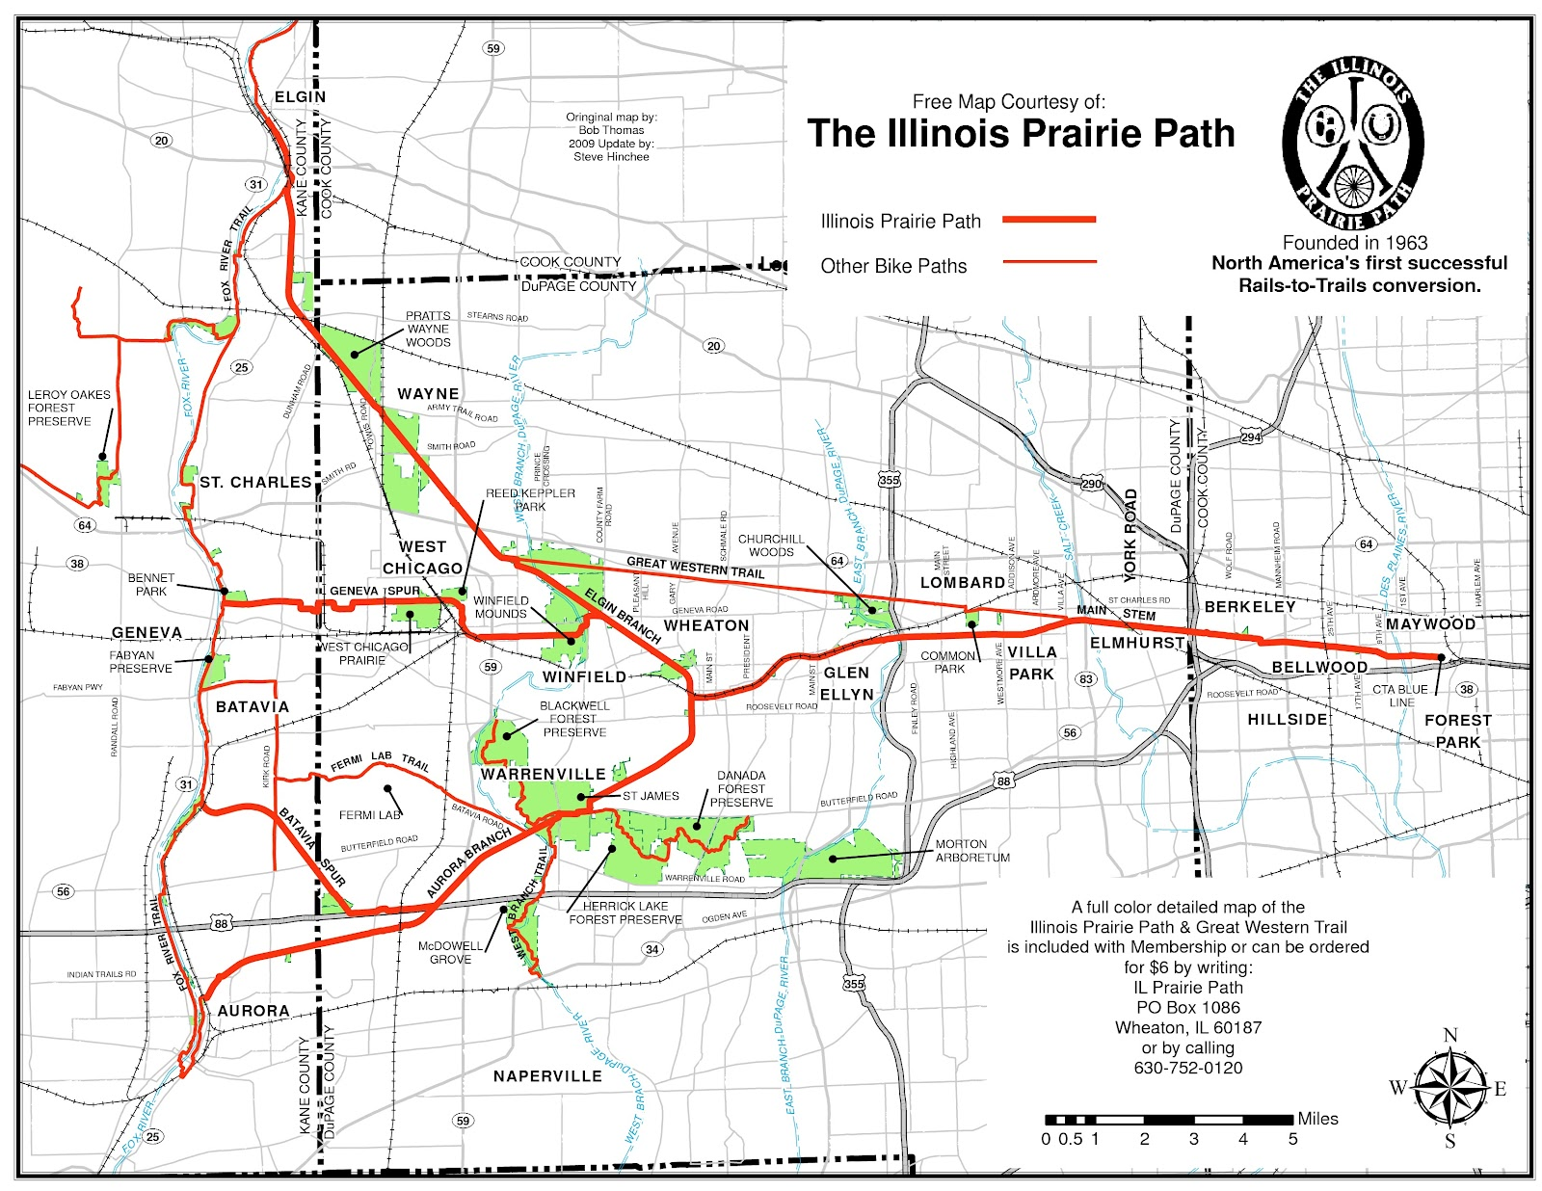
Urban Conservation: Rails to Trails
May Watts, founder of the Illinois Prairie Path (est. 1963)
Notes:
Yet, his literary urban landscape is also a setting haunted by visions of decay and decline, of a crumbling technological civilization succumbing to the inevitable forces of nature reclaiming dominion.

Slide 26
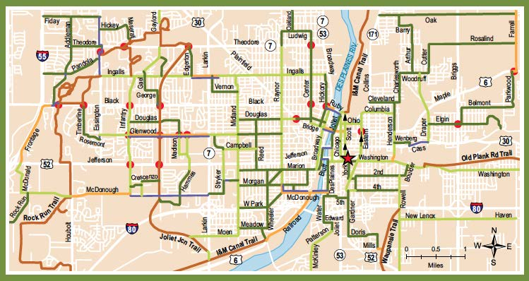
Active Transportation in Small Cities
Bike to Metra (commuter train) Map – Joliet, IL (2010)
Notes:
Getting out of the car and onto the bike

Slide 27
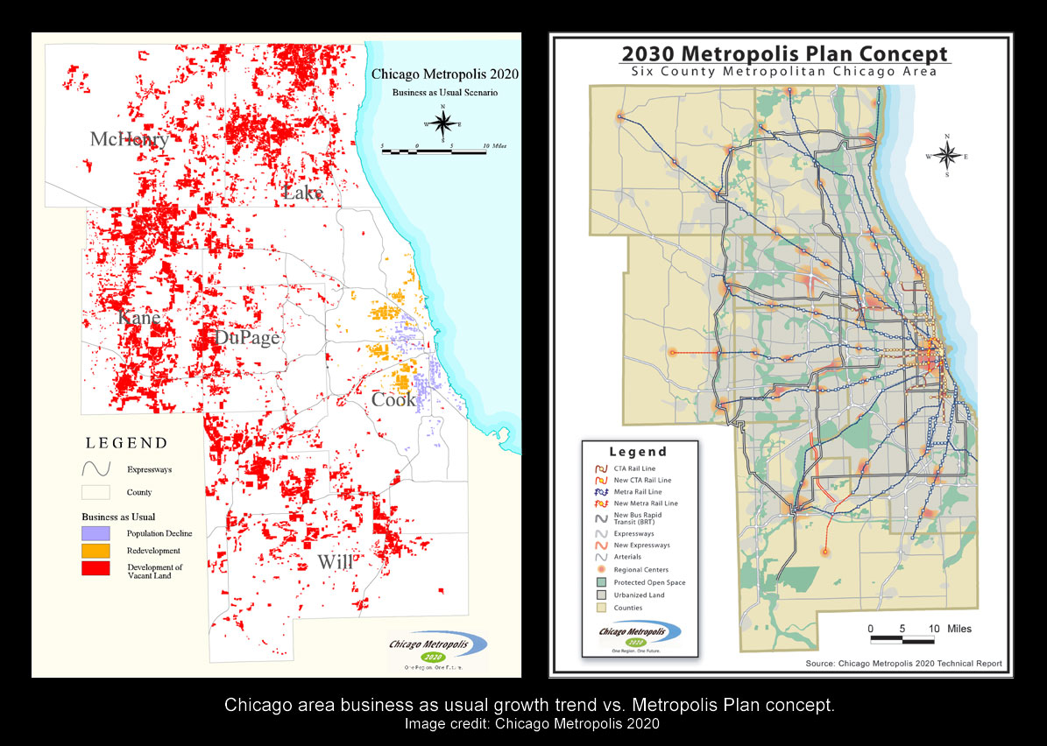
Land Use, Planning, Open Space Conservation
Notes:
Sprawl containment through planning

Slide 28
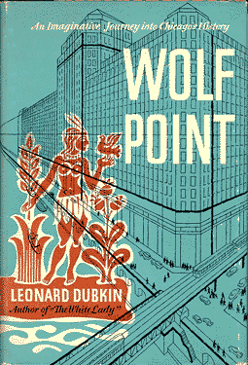
Urban Nature Writing and the Future of Cities
Contributes to the environmental history of our cities and suburbs
Challenges our assumptions about the urbanized landscape, the character of wilderness
Connects us to nature close at hand, underfoot
Exemplifies the engagement of the arts and humanities with ecological problems and environmental issues
Helps us envision what a sustainable city or suburb should be like
Notes:
What's the take-away of Eiseley's work? Not that he had all the answers – far from it – but that he thought about cities as interesting biological landscapes that revealed much about how our species uses (and abuses) land and resources.

Slide 29
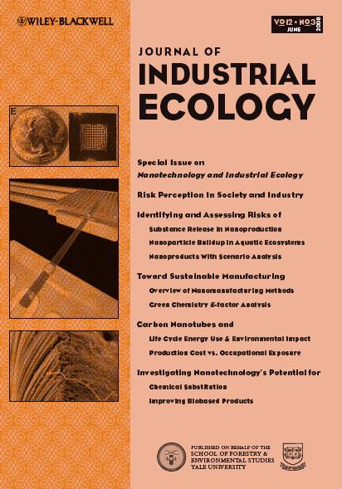
Current Research/Writing Projects
Creative Non-Fiction "Canoeing through History: Wild Encounters on Bubbly Creek." City Creatures blog/book/art project with Center for Humans and Nature (edited volume under review).
Urban Environmental History "Infamous Past, Invisible Present: Searching for Bubbly Creek in the 21st Century." With Carl Zimring. Under consideration by IA -- The Journal of Industrial Archeology (scholarly article under review).
Ecocriticism / Urban Studies Mapping the Urban Wilderness: An Ecological and Literary Topography of Chicago (scholarly monograph, in progress).
Sustainability and Education "Schaumburg's Sustainable Future: Student Research, Social Media, and the 'Edge City' Suburb." Journal of Environmental Studies and Science (scholarly article, in progress).
Journalism / New Media Essayist for City Creatures blog; editor of SUST at RU and Schaumburg's Sustainable Future blogs; op-ed columnist since 2006 for the Joliet Herald-News
Notes:
What's the take-away of Eiseley's work? Not that he had all the answers – far from it – but that he thought about cities as interesting biological landscapes that revealed much about how our species uses (and abuses) land and resources.

Slide 30
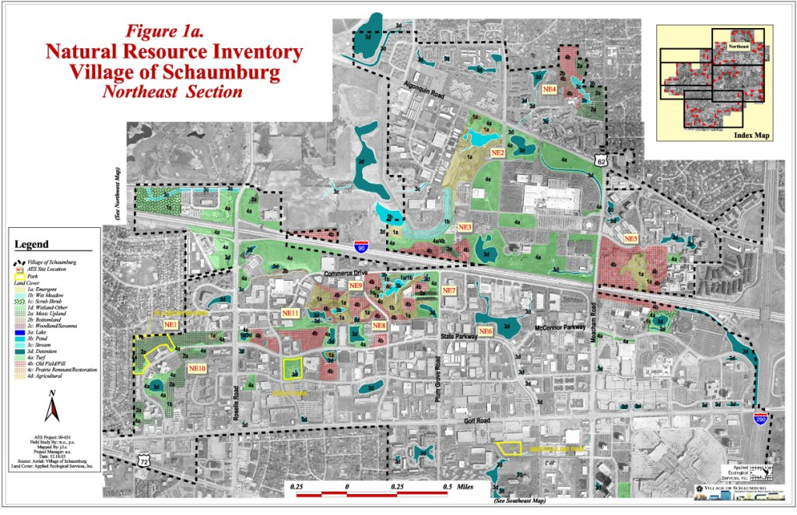
Sustainability in the Suburbs
Mapping Schaumburg's Biodiversity (Schaumburg Biodiversity Plan, 2004)

Slide 31
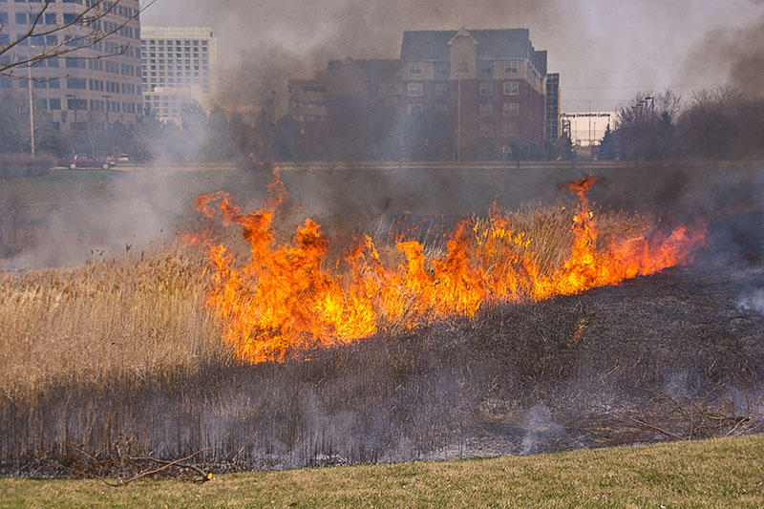
Campus Redevelopment / Student Research Greening RU's Schaumburg IL Campus
Sustainable landscape plan: native plants, prairie plots, walking paths, community garden
Water conservation strategies: bioswales, cisterns, rain gardens, pervious paving
Outdoor education / recreation: experimental wetland restoration, native plant gardens, RUrbanPioneers community garden, greenhouse, EcoSpace courtyard
Academics + Community Engagement:
Schaumburg's Sustainable Future
a student-authored website and blog

