Slide 1
Exploring the Chicago River Science, Policy, Ethics, and Sustainability
Mike Bryson Associate Professor of Humanities & Sustainability Studies Roosevelt University
Environmental Studies Program ENVI 305 Guest Lecture
Roanoke College
15 January 2014

Slide 2
Context: urban nature and the Chicago River
Exploration: connecting with the river
Science: assessing water quality
Policy: tackling the Asian carp controversy
Ethics: thinking like a watershed

Slide 3
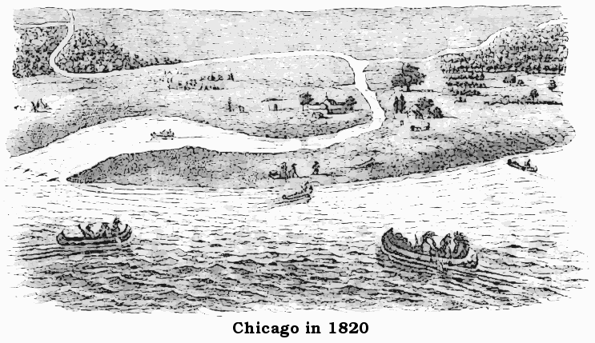
Urban Nature & the Chicago River
Postcard depiction of the mouth of the Chicago River

Slide 4
Urban Nature & the Chicago River
Chicago in 1857
Notes:
Chicago has always been defined by its namesake river and Lake Michigan – a place where nature, culture, and commerce intermingle. To know this place, one must have a sense of its environmental history: land ecosystems (prairie, woodland, wetland) and aquatic systems.

Slide 5
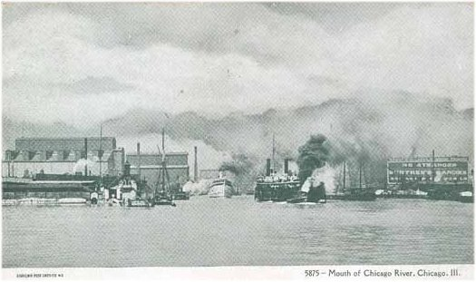
Urban Nature & the Chicago River
Postcard depiction of the mouth of the Chicago River, c. 1906

Slide 6
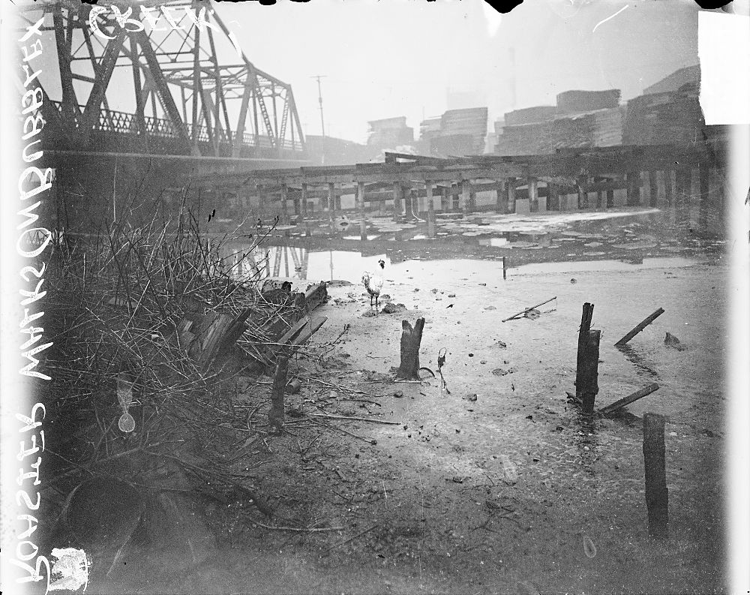
Urban Nature & the Chicago River
A chicken stands upon Bubbly Creek, c.1911 (Chicago Historical Society)

Slide 7
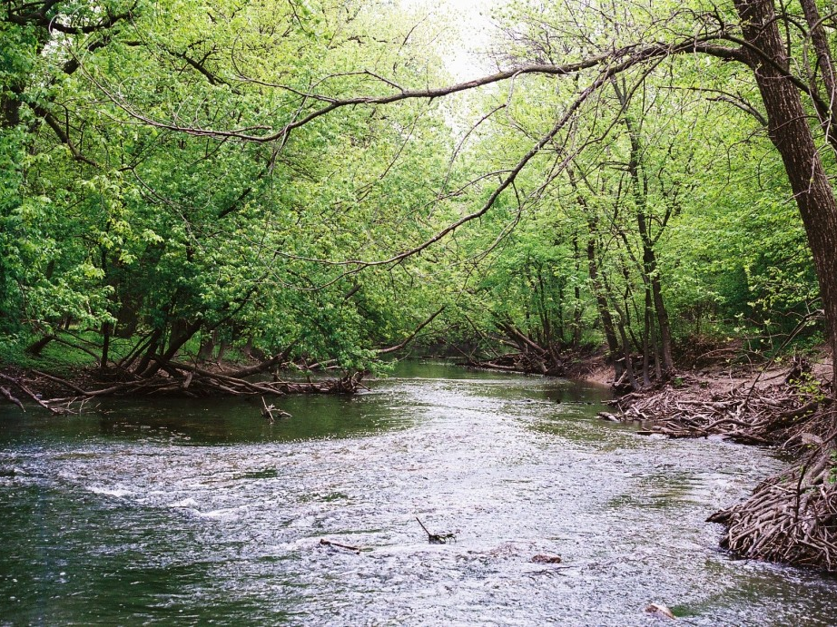
Urban Nature & the Chicago River
North Branch of the Chicago River, spring 2010 (M. Bryson)
Notes:
Wilderness in the city? This is the North Branch of the Chicago River, where it flows through neighborhoods on Chicago's NW side.

Slide 8
Urban Nature & the Chicago River
Jardine Water Filtration Plant on Chicago's downtown lakefront
Notes:
Lake Michigan and the Jardine Water Purification Plant: sustaining our fresh water supply, the ecological health of Lake Michigan, etc.
Navy Pier: city culture and water are intimately connected
Mouth of the Chicago River (off-camera right): ecological and economic connection of river and lake

Slide 9
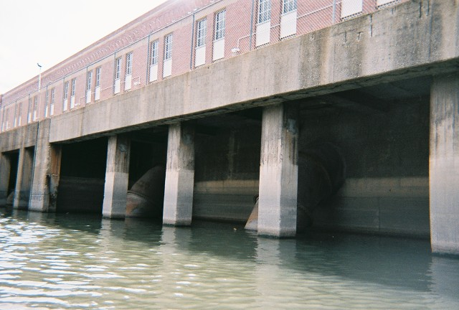
Urban Nature & the Chicago River
WMRD's Racine Avenue Pumping Station, headwaters of Bubbly Creek
Chicago, May 2009 (M. Bryson)
Notes:
This is the river, too: the "hardscape" of the CAWS

Slide 10
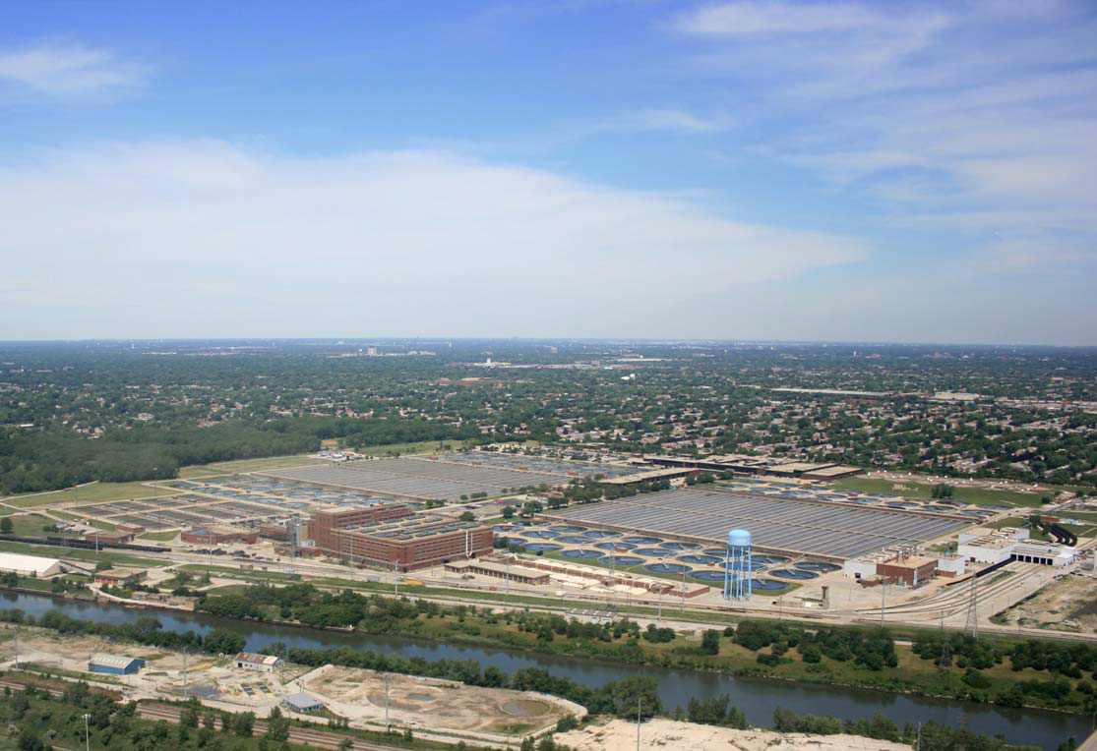
Urban Nature & the Chicago River
The Stickney Wastewater Treatment Plant, SW of Chicago (MWRD)
Notes:
In the foreground, the Sanitary and Ship Canal, which transports Chicago's (and much of Cook County's) wastewater effluent across an ancient continental divide and thence "downstream" via the Des Plaines, Illinois, and Mississippi Rivers to the Gulf of Mexico.

Slide 11
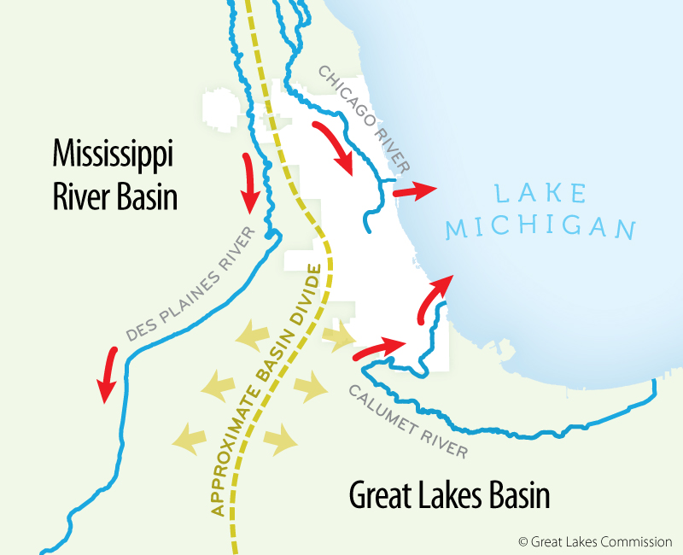
Transformations of the Chicago River

Slide 12
Transformations of the Chicago River
The CAWS
Chicago Area Waterway System
rivers
canals
locks
control structures
Notes:
The Chicago River – a working waterway, but also a living ecosystem. What is natural and what is human-made is not always clear-cut.

Slide 13
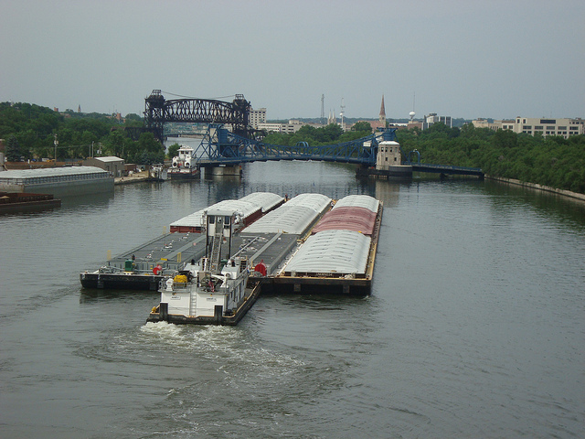
Discussion: What's in a Name? (CAWS vs. River)
The Des Plaines River in my hometown of Joliet IL, part of the Illinois Waterway transportation system which connects the Great Lakes to the Gulf of Mexico

Slide 14
Exploring the River: a Multidisciplinary Endeavor
Understanding the river as a modified natural ecosystem (natural sciences)
Developing conservation policies (social and natural sciences)
Representing the river as a cultural resource (arts and humanities)
Restoring the river: water quality, biodiversity, riparian zone integrity, citizen access and recreation (all disciplines)
Sense of Place | Urban Sustainability
Notes:
Understanding the river requires a multi-disciplinary approach; not just science (important as that is), but also policy analysis, environmental history, even literature and art.

Slide 15
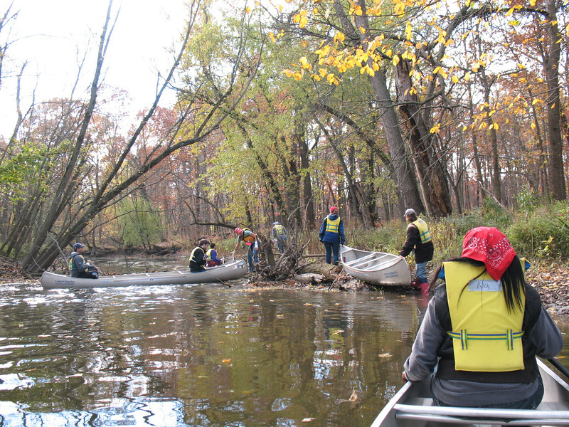
Canoeing the Upper North Branch
Paddling the West Fork of the Upper North Branch: portage around
a fallen tree in the Cook County Forest Preserve (October 2012)
Notes:
The river as an ecological asset: the Upper North Branch flows through many forest preserve areas in the northern suburbs and the North Side of Chicago, providing a wilderness aesthetic and back-country experience close-at-hand for urban denizens. The beauty of the river here belies a still significant level of pollution from non-point runoff, streambank erosion, etc.

Slide 16
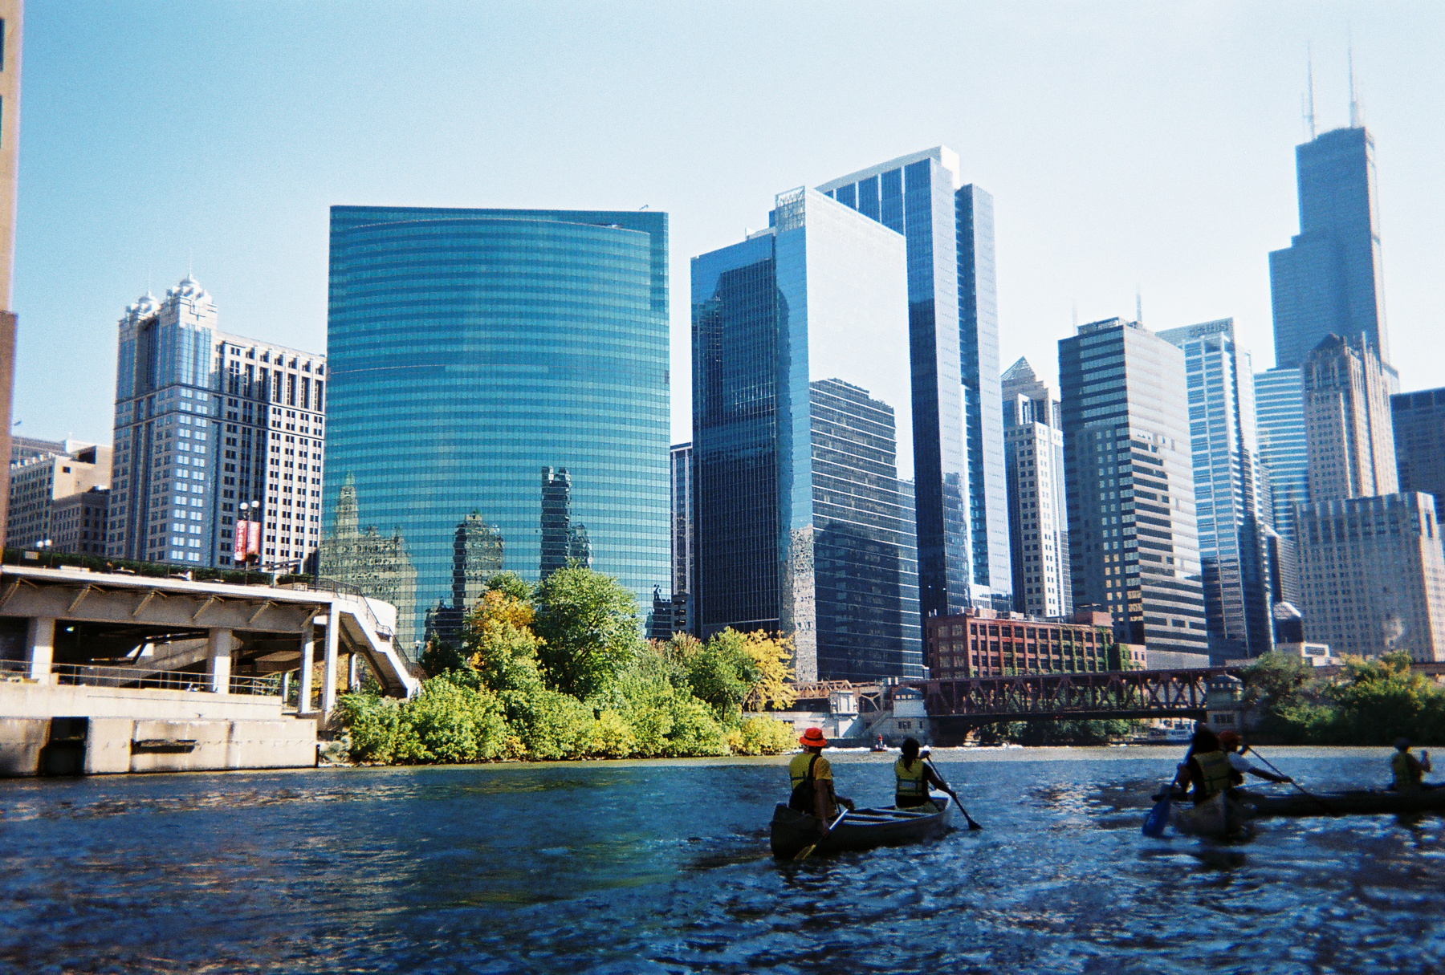
Canoeing the Confluence
Heading south into the Loop where the branches meet;
Wolf Point in the background (October 2011)
Notes:
Exploring the river in downtown Chicago highlights its value as a civic asset: here it's readily apparent that the river as an aesthetic and economic resource. Riparian zones are critical "green space" within in the urban landscape. Wolf Point as an under-realized resource and important historical spot.

Slide 17
Canoeing the South Branch
The mouth of Bubbly Creek, an industrialized tributary of the South Branch
of the Chicago River (May 2009)
Notes:
Canoeing on Bubbly Creek, a historically significant but mostly overlooked and neglected tributary of the river's South Branch, inspires all kinds of questions: What's the value of canoeing an urban river? What do we learn from such an adventure? How does it change our perspective on water, on the city, on urban nature?

Slide 18
Canoeing the South Branch
Heading upstream on Bubbly Creek (Oct 2010)
Notes:
Canoeing on Bubbly Creek, a historically significant but mostly overlooked and neglected tributary of the river's South Branch, inspires all kinds of questions: What's the value of canoeing an urban river? What do we learn from such an adventure? How does it change our perspective on water, on the city, on urban nature?

Slide 19
Cleaning up Bubbly Creek
Hauling trash from the banks of Bubbly Creek (Feb. 2013)

Slide 20
Hiking the Continental Divide
Exploring the woods at the Chicago Portage National Historic Site,
a few miles SW of Chicago (Feb. 2013)

Slide 21
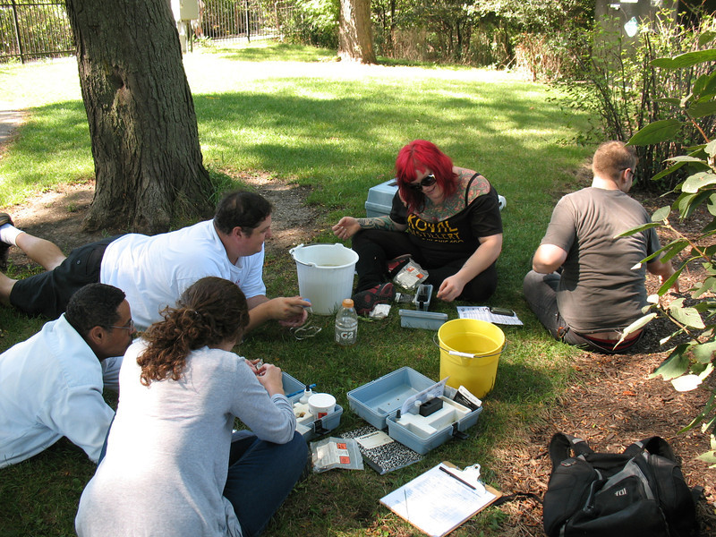
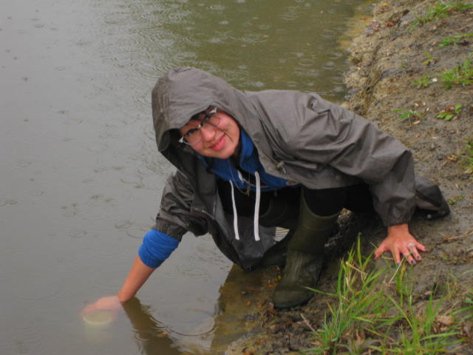
Science: Assessing Water Quality
Temperature
pH
Turbidity
Dissolved oxygen (DO)
Nutrients (nitrate, phosphate)
Bacterial indicators (coliform)
Metals and organic contaminants (lead, copper, benzene, PCBs, hexavalent chromium)
Emerging contaminants (pharmaceuticals, synthetic hormones, flame retardants)
Notes:
Science gives us the tools to understand the biochemistry of the river and the impact of pollution on the food chain as well as on human health.

Slide 22
Science: Assessing Water Quality
Sampling macro-invertebrate benthos in the North Branch (May 2010)
Notes:
Biological sampling is important, too, and inspires a different kind of intimacy with the river – here students "muck about" in the sediment in order to sample the benthic fauna, which gives us a temporal assessment of the river's health (rather than data on a single point in time).

Slide 23
Science: Assessing Water Quality
Identifying macro-invertebrates from the North Branch (May 2010)
Notes:
Studying the river up close and personal is more than about learning field ecology techniques. You can even make connections with the community (like the neighborhood kids who joined in our fun).

Slide 24
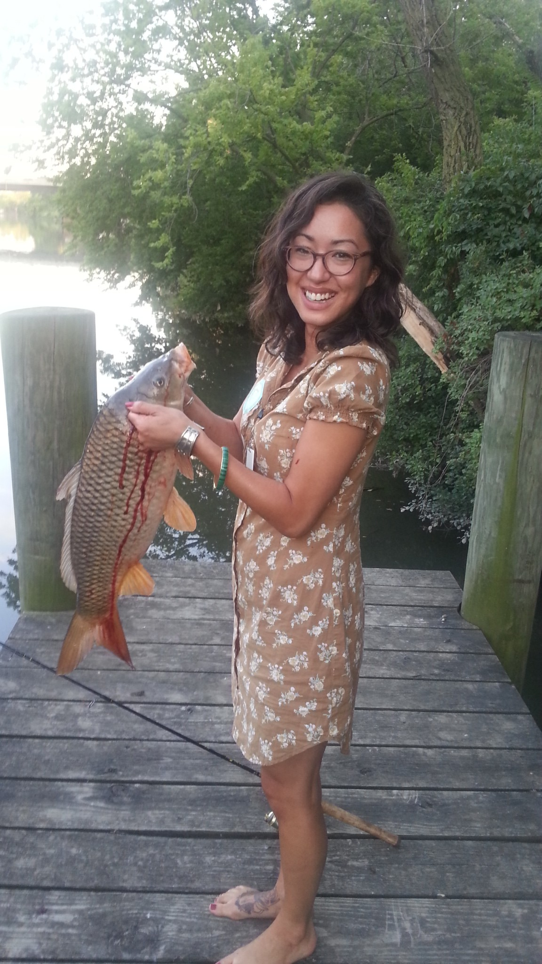
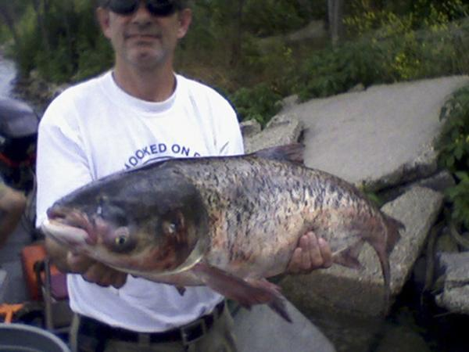
Biodiversity Meets Policy:
Asian Carp, the River, & the Great Lakes
Left: RU senior SUST major Kristina Lugo catches a Common Carp from her secret spot on the North Branch of the Chicago River
Above: a Bighead Carp from the Illinois River

Slide 25
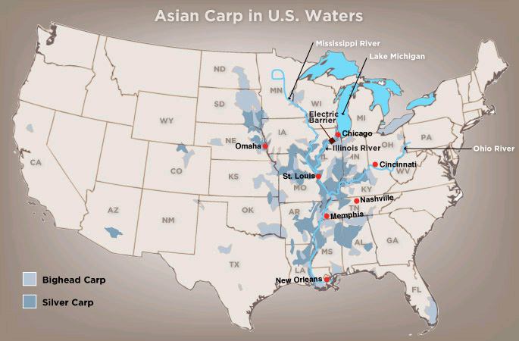
Since their introduction to the US in the 1970s, Asian Carp have become widespread within the Mississippi, Missouri, and Ohio River basins. Chicago is the gateway to the Great Lakes watershed. (Map: NPR)

Slide 26
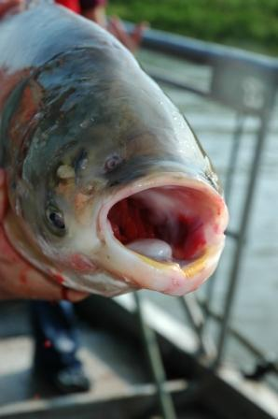
Policy: Asian Carp, the River, & the Great Lakes
The Silver and Bighead Carp are non-native species introduced in the US to control algal growth in aquaculture ponds in the 1970s
They escaped confinement and have spread rapidly throughout the Mississippi River basin during the 1990s and 2000s
These fast-growing species grow rapidly to a large size (50+ lbs) and consume up to 40% of their body weight in plankton per day; they also reproduce rapidly
Environmental impacts include disruption of food chain, displacement of native fish species, danger to boaters (the silver carp jump when disturbed)
Current crisis: the impending invasion of Asian Carp into the Great Lakes watershed via the Chicago and Calumet Rivers
Photo: Great Lakes Fisheries Commission

Slide 27
Silver Carp leaping from the Illinois River, where they are very numerous along with Bighead Carp. Such behavior poses a significant boating hazard. (Photo: Great Lakes Fisheries Commission)

Slide 28
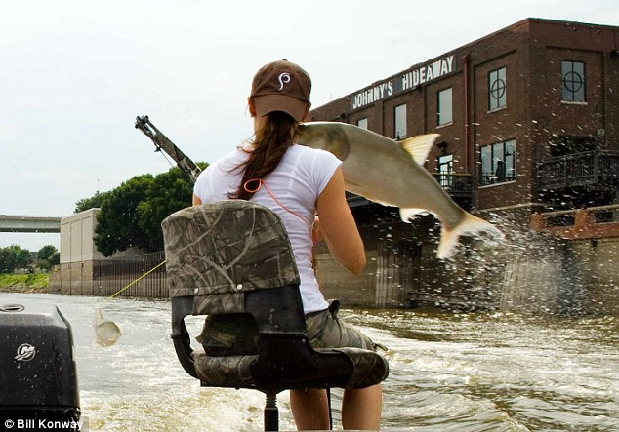
Watch yourself: bow-hunter on the Illinois River being hit by a silver carp (photo: Daily Mail, UK). Asian Carp are now being harvested for sport and commercial processing in Illinois.

Slide 29
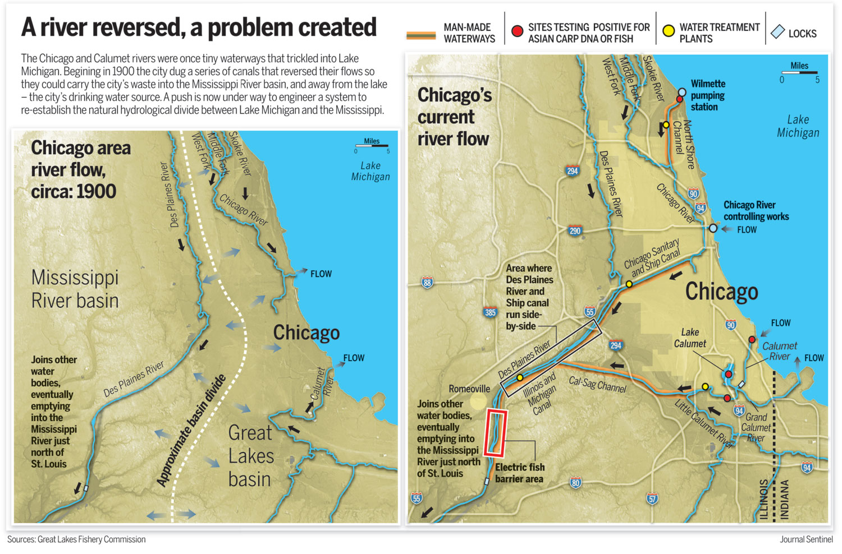
These maps from the Great Lakes Fisheries Commission show the pre-1900 hydrology of the Chicago-area waterways; note the continental divide. The right map shows current flows, location of locks and water treatment plants, and A. carp sightings as of summer 2010.

Slide 30
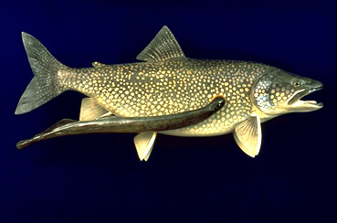
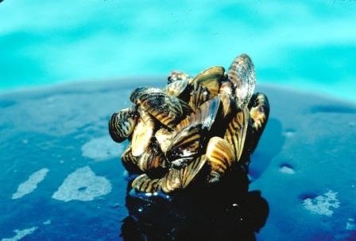
Invasive Species of the Great Lakes
Sea Lamprey
Petromyzon marinus
Origin: Atlantic ocean
Introduced: 1835 (Lake Ontario)
Impacts: Parasite on fish; devastation of whitefish, lake trout, chub in ‘40s and ‘50s; in all the Great Lakes, esp. Huron
Costs: $13 million / year for control
Zebra Mussel
Dreissena polymorpha
Origin: Caspian Sea
Introduced: 1988
Impacts: Displacement of native clams and mussels; clogging of water intake pipes; has spread to all GLs, Mississippi River, and inland lakes
Costs: Several hundred million $ / year

Slide 31
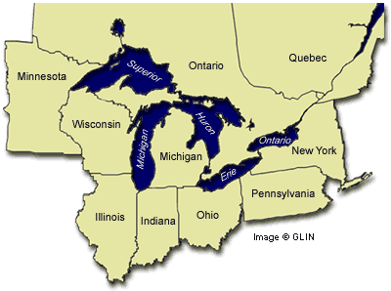
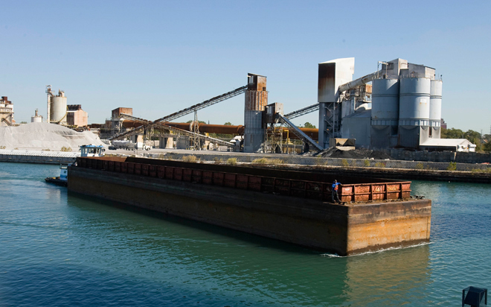
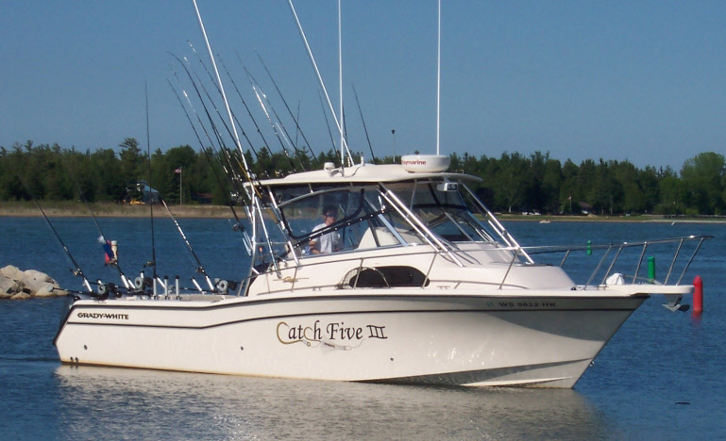
Policy Debates: Asian Carp Discourse
State vs. State
Environment vs. Industry
Fishing vs. Shipping
The debate about Asian Carp occurs along these three axes, which makes it particularly complex. Great Lakes states have lined up against Illinois politically and legally to try to force the US Army Corps of Engineers to close the locks providing access to the Great Lakes from the CAWS, so far unsuccessfully. But the debate also pits different industries against one another, given the value of the GLs sport and commercial fisheries.

Slide 32
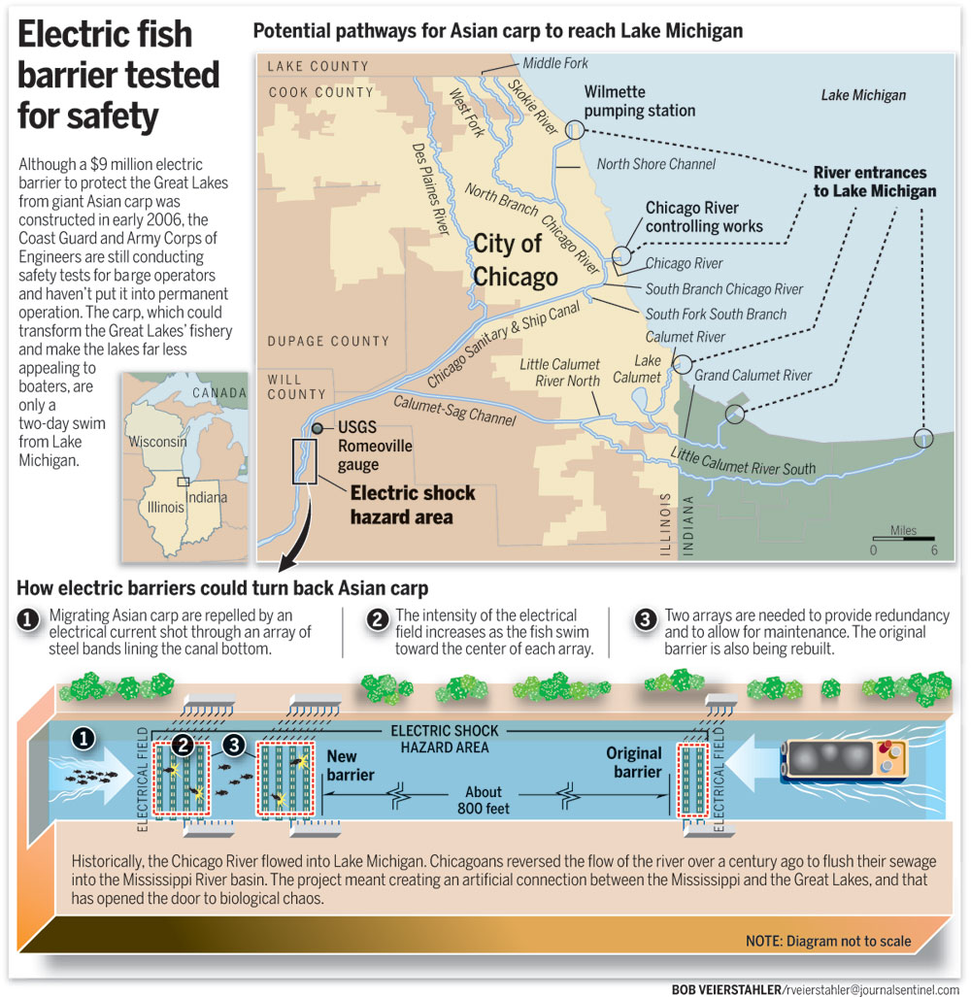

Slide 33
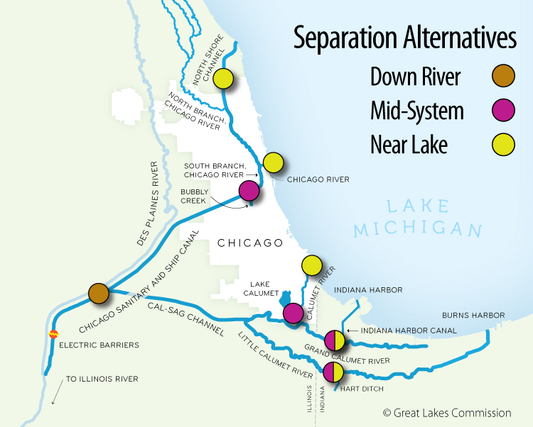
Proposed Solution: Watershed Separation

Slide 34
Future Impacts of Asian Carp:
Sources of Uncertainty
The validity of eDNA detection techniques pioneered by David Lodge of the University of Notre Dame, which provide a cost-effective tool to detect the presence of carp in waterways
The experimental nature of the electric barrier at Romeoville on the Sanitary and Ship Canal, which provides no guarantee of keeping the carp at bay
The timing of the carp's entry into Lake Michigan – scientists mostly agree that this it not a matter of if, but when, though they cannot predict when that will be
The environmental and economic impacts upon Great Lakes ecosystem, perhaps the toughest things to estimate of all
The potential efficacy of watershed separation, since localized flooding could still provide a temporary avenue to the Lakes
Background image: David Lodge's eDNA lab at the Univ. of Notre Dame (Gary Porter, Milwaukee Journal-Sentinel)

Slide 35
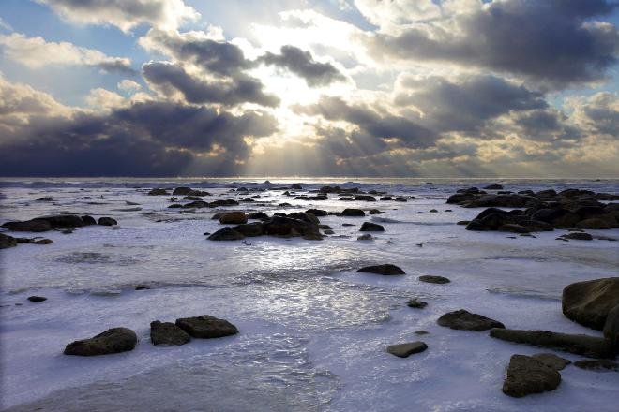
Discussion: Science, Uncertainty, & Environmental Policy
Lake Michigan as seen from Milwaukee, WI (Milwaukee Journal-Sentinel)

Slide 36
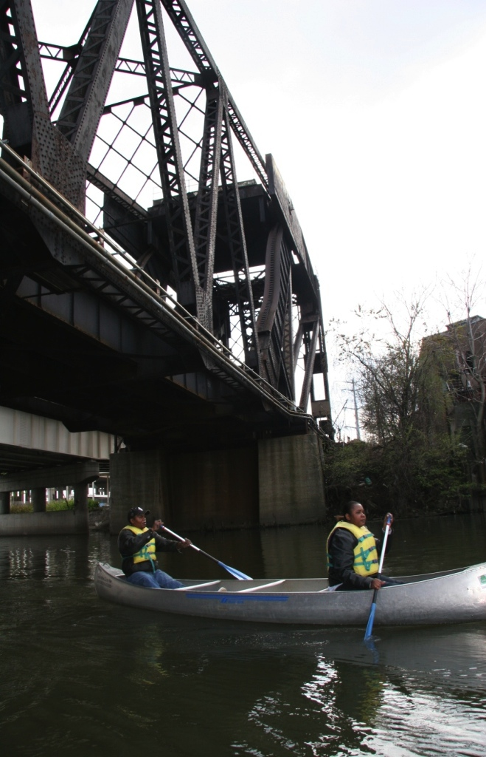
Environmental Ethics & Sustainability
In a Sustainable Future:
Environmental resources are conserved for both future human generations as well as non-human biota.
Economic development occurs not at the expense of the natural environment, but in a way to mitigate ecological costs and impacts.
Equity – social, economic, and environmental justice – governs the process of sustainable development.

Slide 37
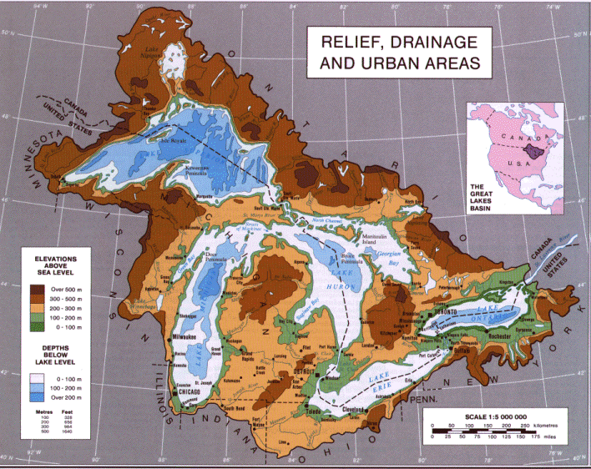
Ethics: Thinking Like a Watershed

Slide 38
Ethics: Thinking Like a Watershed

Slide 39
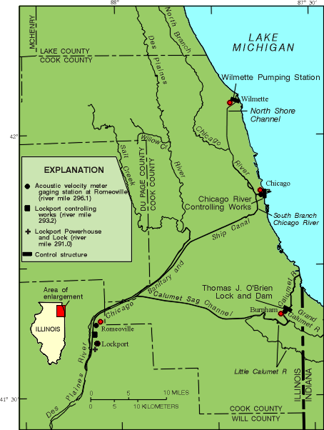
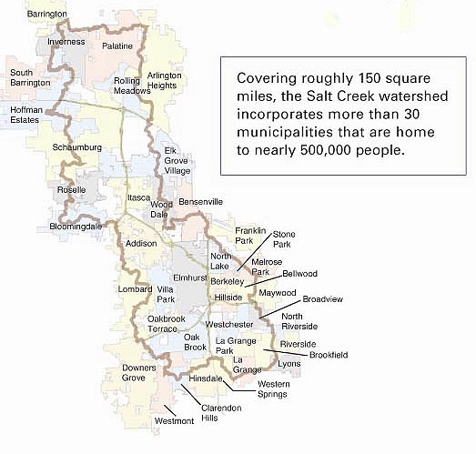
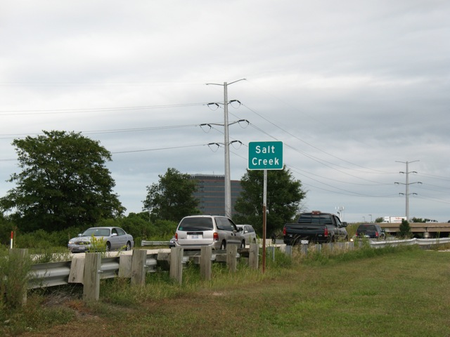
Ethics: Thinking Like a Watershed
Notes:
One community's water issues are not isolated and independent from other those of other communities. That's what we learn from a "watershed view" of the land, as depicted in this map of Salt Creek's watershed.

Slide 40
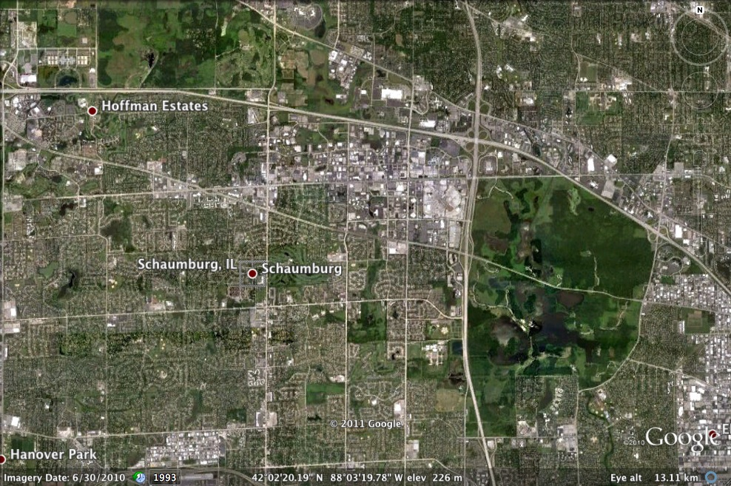
Ethics: Thinking Like a Watershed
Chicago's Northwest Suburbs / Busse Woods Forest Preserve
Notes:
That's why green infrastructure is so important. Here we see Schaumburg in the larger context of Chicago's NW suburbs and a couple of large Cook County Forest Preserve units: the Paul Douglas (partial view, upper left) and the Ned Brown / Busse Woods (lower right) forest preserves. Besides recreation and wildlife habitat, these green oases absorb tremendous amounts of precipitation as well as run-off from the surrounding hardscape, and thus act as giant sponges – taking in water and holding it, then releasing it slowly over time.

Slide 41
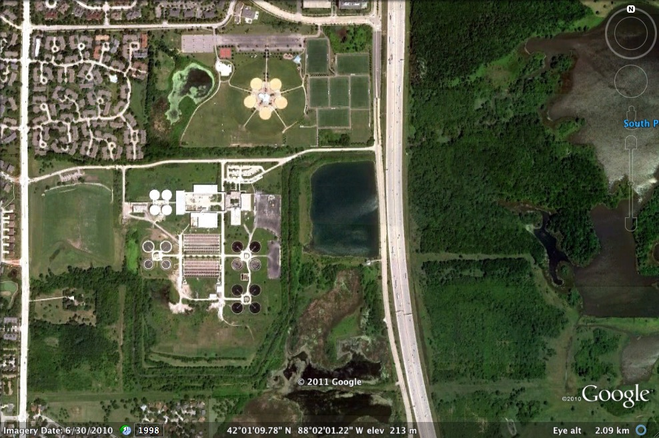
Connections: Water / Green Infrastructure
John Egan Wastewater Treatment Plant, Schaumburg IL / Busse Woods
Notes:
Here's an extraordinary view of the connection between "hard path" technology and "soft path" green infrastructure. The West Branch of Salt Creek winds around the John Egan wastewater treatment plant, which cleans sewage and then releases it into the creek; from there, the West Branch flows west into the South Pool of Busse Lake.

Slide 42
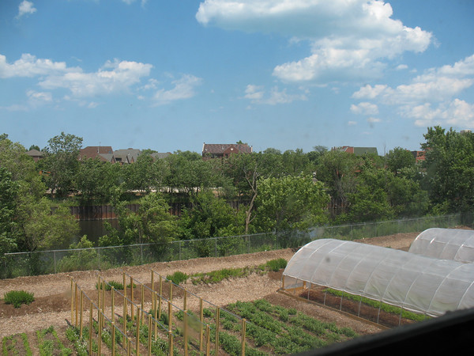
Connections: Water / Urban Land Use / Food
Growing Power's Iron Street Farm in Chicago, on the west bank of Bubbly Creek (2012)
Notes:
Iron Street Farm, on the west bank of Bubbly Creek – another story about the relation between land and water, people and nature, city and country.

Slide 43
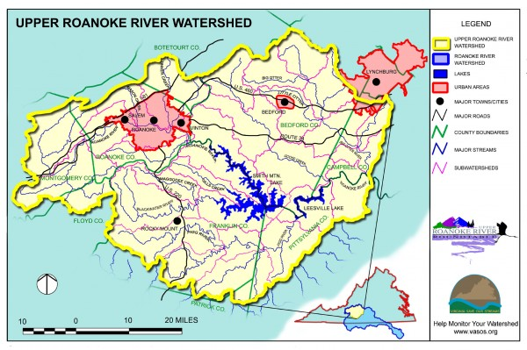
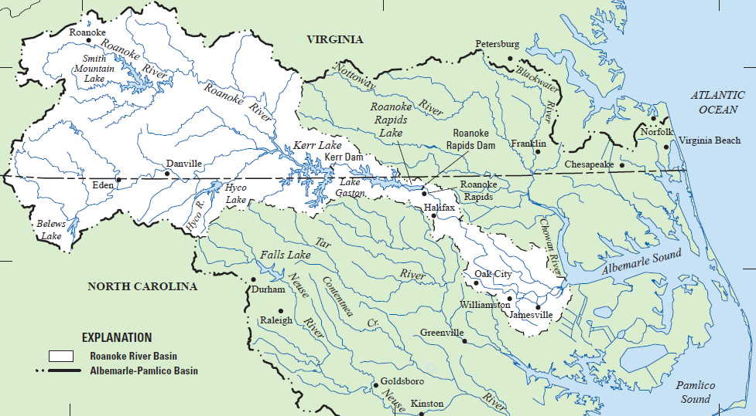
Discussion: What about Your Watershed?
Source: Catawba Landcare
Sources: USGS (bottom map), Catawba Landcare (top)

Slide 44
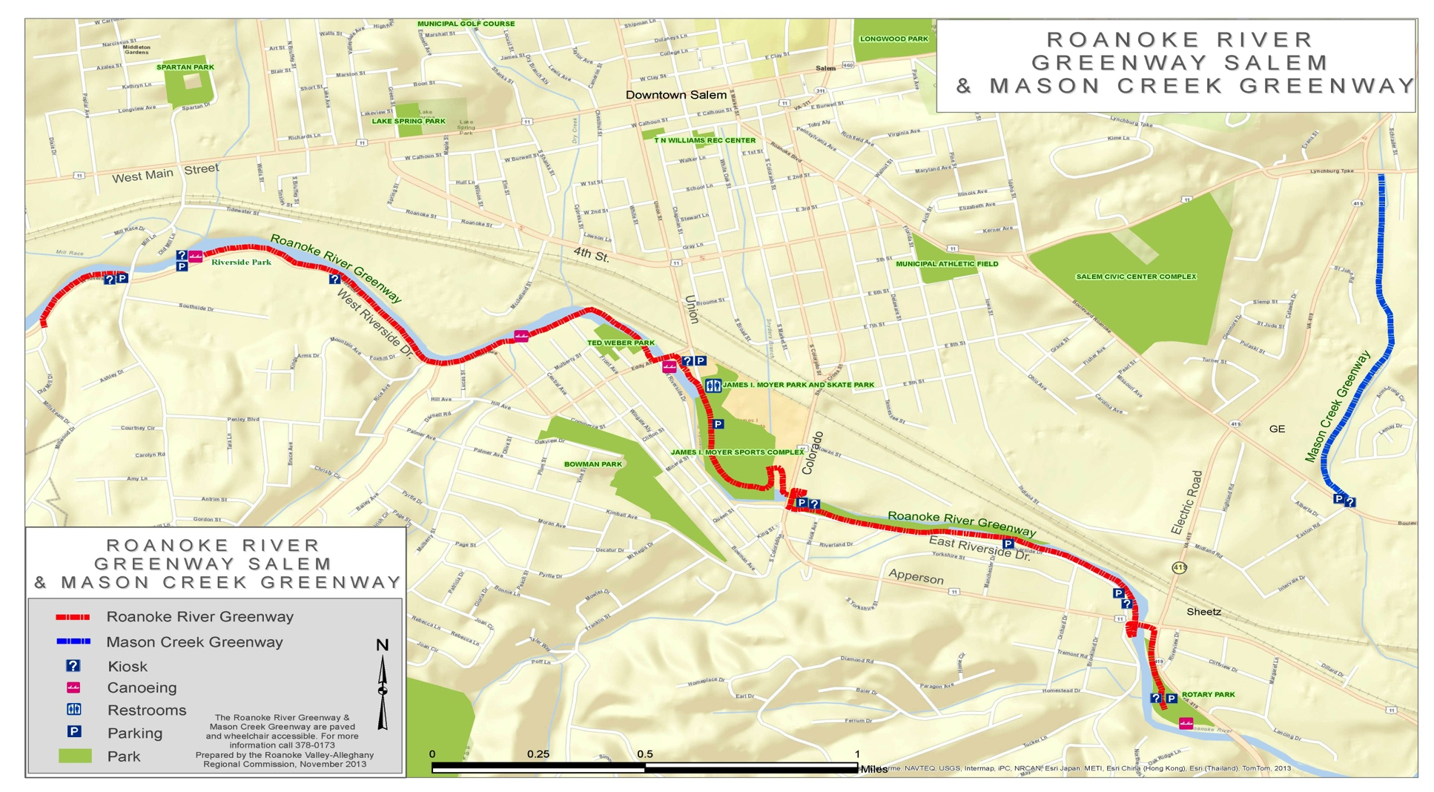
Discussion: What about Your Watershed?
Source: Catawba Landcare
Notes:
Iron Street Farm, on the west bank of Bubbly Creek – another story about the relation between land and water, people and nature, city and country.

Slide 45
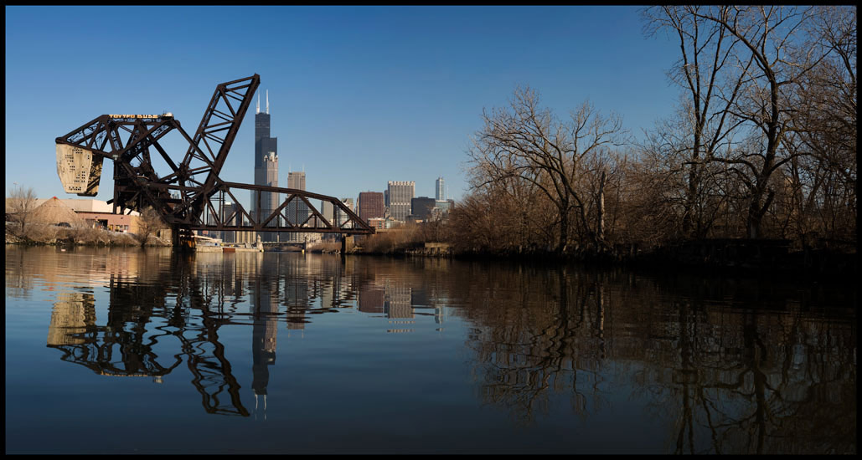
Thank You
The Chicago River: photo by Ryan Hodgson-Rigsbee
Notes:
Art as a form of visual exploration and cultural critique. Here, a study in binaries: hinterlands/city, natural/built environment, wild/controlled, industry/commerce

